Slide 1
Support at least 150 European regions and communities to become climate resilient by 2030
Johannes Klumpers
Notes:
- EU missions are addressing the greatest challenges facing our world like fighting cancer, adapting to climate change, protecting our oceans, living in greener cities and ensuring soil health and food.
- Missions are solutions-oriented

Slide 2
The Mission – History of driving forces
Actors
Reading*
Commissioner Carlos Moedas
Mariana Mazzucato
Other expert groups
LAB – FAB – APP
Mission-Oriented Research and Innovation: Inventory and characterisation of initiatives
Mission-oriented research & innovation in the European Union: A problem-solving approach to fuel innovation-led growth
Governing Missions: Governing Missions in the European Union
*https://ec.europa.eu/info/research-and-innovation/funding/funding-opportunities/funding-programmes-and-open-calls/horizon-europe/missions-horizon-europe/mission-oriented-policy-studies-and-reports_en

Slide 3
The Mission – History
Legislation
Proposal HE regulation June 2018
REGULATION (EU) 2021/695 OF THE EUROPEAN PARLIAMENT AND OF THE COUNCIL of 28 April 2021
Mission Board
2020-09-21 a Climate resilient Europe
Climate Policy
COMMUNICATION FROM THE COMMISSION TO THE EUROPEAN PARLIAMENT, THE COUNCIL, THE EUROPEAN ECONOMIC AND SOCIAL COMMITTEE AND THE COMMITTEE OF THE REGIONS Forging a climate-resilient Europe - the new EU Strategy on Adaptation to Climate Change. COM/2021/82 final
Implementation Plan
Nomination Mission Manager Feb 2021
Mission secretariat
Implementation

Slide 4
Green Deal Missions:
Adaptation to Climate Change
Climate-neutral and Smart Cities
Restore our Ocean and Waters
Soil Deal for Europe
Objective:
Support at least 150 European regions and communities towards climate resilience by 2030
Notes:
Adopted by European Commission on 29 September 2021
To:
foster Europe’s resilience to climate change at local and regional level while engaging citizens
help prepare for unavoidable climate impacts and accelerate Europe’s transformation into a climate-resilient continent.
Specific obj. 1: Preparing and planning for climate resilience: Provide general support to European regions and communities to better understand, prepare for and manage climate risks and opportunities
Specific obj. 2: Accelerating transformations to climate resilience: Work with at least 150 regions and communities to accelerate their transformation to a climate resilient future, supporting them in the co-creation of innovation pathways and the testing of solutions
Specific obj. 3: Demonstrating systemic transformations to climate resilience: Deliver at least 75 large-scale demonstrations of systemic transformations to climate resilience across European regions and communities.

Slide 5
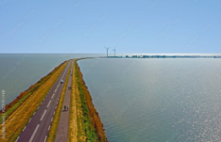
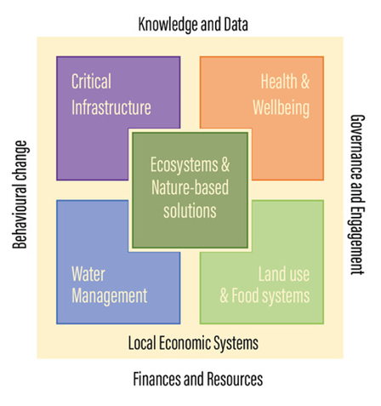
Innovation areas
© picture: Peter Lőffler

Slide 6
Phases
Build-up (2021-2023)
Set up of support system
Full deployment (2024-2027)
adjustments
Consolidation (2028-2030)
Consolidation of results
During this phase, some 60-100 regions and communities will have started to be engaged in the Mission
Evaluation
engaging more regions and innovation areas
First recommendations on how to reach a climate change resilient Europe
Focus on large scale demonstration

Slide 7
How will the Mission support the Regions?
MIP
Horizon Europe
Calls
PCP and PPI
EIB
and other Programmes
Climate-ADAPT
JRC
Horizon Europe project grants: calls currently opened and future yearly calls (eg possible support to public procurers to buy innovative/pre-commercial solutions for climate resilience)
Services by Mission Implementation Platform (MIP)
Scientific guidance and support by JRC
Access to climate adaptation knowledge from Climate-ADAPT by EEA

Slide 8
Work Programme 2021: RECAP
Topic | Action description | Type of action | Budget In millions EUR
HORIZON-MISS-2021-CLIMA-02-01 | Development of climate change risk assessments in European regions and communities based on a transparent and harmonised Climate Risk Assessment approach | RIA | 20 with 60% cascading funds
HORIZON-MISS-2021-CLIMA-02-02 | Support to the regions in developing pathways towards climate resilience and corresponding innovation agendas | RIA | 30 With 70% cascading funds
HORIZON-MISS-2021-CLIMA-02-03 | Towards asset level modelling of climate risks and adaptation | RIA | 5
HORIZON-MISS-2021-CLIMA-02-04 | Large scale demonstrators of climate resilience creating cross-border value | IA | 50
HORIZON-MISS-2021-CLIMA-02-05 | Local engagement of citizens in the co-creation of societal transformational change for climate resilience | RIA | 5
Other actions | Building the Implementation Platform for the Adaptation to Climate Change Mission | Public Procurement | 10
Help at least 150 European regions and communities towards climate resilience by 2030

Slide 9
Work Programme 2022
Topic | Action description | Type of action | Budget In millions EUR
HORIZON-MISS-2022-CLIMA-01-01 | User driven applications and tools for regional and local authorities, and other end users focusing on climate impacts, data and knowledge | RIA | 6
HORIZON-MISS-2022-CLIMA-01-02 | Unlocking of financial resources for investments into climate resilience | RIA | 6
HORIZON-MISS-2022-CLIMA-01-03 | Best practices on and piloting insurance solutions for climate adaptation in EU regions and communities | RIA | 6
HORIZON-MISS-2022-CLIMA-01-04 | Transformation of regional economic systems for climate resilience and sustainability | RIA | 6
HORIZON-MISS-2022-CLIMA-01-05 | Boost the sponge function of landscape as a way to improve climate-resilience to water management challenges | RIA | 3
HORIZON-MISS-2022-CLIMA-01-06 | Testing and demonstrating transformative solutions on climate resilience, mainstreaming nature based solutions in the systemic transformation | IA | 88
HORIZON-MISS-2022-OCEAN-CLIMA-01-01 | Joint demonstration for coastal resilience in the Arctic and Atlantic sea basin | IA | 20
Help at least 150 European regions and communities towards climate resilience by 2030

Slide 10
The Mission Charter
How?
Fill in the dedicated EU Survey
Evaluation of your commitments to climate adaptation by the Mission Secretariat
Get invited to sign the Mission Charter
When?
No deadline to apply. Open and inclusive process.
First signatories will be announced at the First Mission Forum
Who?
Representatives from regional and local authorities will sign the Mission Charter on behalf of their respective authorities.

Slide 11
Support through the Mission Implementation Platform (early 2023)
Capacity building and development
Knowledge on risk assessment methods
Citizens engagement
Access tools that the region can use to engage with citizens
Monitoring
and
evaluation
Communication
and
dissemination
Support to carry out climate risk assessments
Support to accelerate the roll-out of innovative solutions
Direct organization of events that empower citizens to act for adapting to climate change (together with the ClimatePact)
Network with other regions
Sharing experiences
Access adaptation best practices
from previous projects
Tracking progress and reporting on the Mission different streams of activities
Visibility for regional efforts and progress to tackle climate change

Slide 12
The Mission Charter
260 applications received in total
118 signatories announced on June 7 at the Mission Forum
17 Friends of the Mission announced

Slide 13
First Mission signatories @ the Mission Forum
Press release and Factsheet available at:
ec_rtd_eu-climate-mission-meet-the-regions.pdf (europa.eu)

Slide 14
The Mission Forum
First ever Mission Forum
Important element of governance
150 participants in the room, 120 linked through Interactio, 1200 participants on-line, 200 participants participating in the sli.do polls.
Links between European, national and regional level discussed
Approach confirmed
Urged to work across Missions (especially Cities and Adaptation)
Financing and combination of finances identified as a major headache for regions
Not enough skilled staff in regional administrations

