Slide 1
OCTA Webinars on EU Programmes Introduction to the Horizon Europe Missions
Mission Restore our Ocean and waters
22 June 2022
Andreea Strachinescu – Head of the Maritime Innovation, Marine Knowledge and Investment Unit - European Commission - DG MARE

Slide 2
European Missions: a new approach to address major challenges
European Missions are a new way to bring innovative solutions to some of our greatest challenges: the restoration of our ocean and waters is one of them!
They have ambitious goals and will deliver concrete results by 2030: Mission ocean and waters has 3 main policy objectives and 2 enablers
Missions will operate as a portfolio of actions – such as R&I projects, policy/legislative initiatives, citizen engagement, finance and investments: joining forces around Mission ocean and waters objectives is crucial!
Notes:
Speaking notes:
European Missions are a new instrument of the Horizon Europe Programme to bring concrete solutions to the greatest challenges, such as fighting cancer, adapting to climate change, protecting the ocean, seas and waters, living in greener cities and ensuring healthy soil and food. Missions entail a new collaborative approach to address these challenges. They provide a mandate to achieve specific goals in a set timeframe. They will deliver impact by putting research and innovation into a new role, combined with new forms of governance and collaboration, as well as with a new way of engaging with citizens, including young people.
They support Commission priorities, such as the European Green Deal, Europe fit for the Digital Age, Beating Cancer and the New European Bauhaus. For instance, Mission Climate is already a concrete element of the new Climate Adaptation Strategy, Mission Cancer of the Europe’s Beating Cancer Plan and the Mission Soil is a flagship initiative of the Long-term Vision for the EU’s Rural Areas.
Their novelty and added value is in operating as a portfolio of actions involving different instruments, business models and public and private investments at EU, national, regional and local levels. For missions to be successful, support from other European and national programmes will be crucial. European missions connect directly to citizens, engaging them in their design, implementation and monitoring. Member States, regions and a wide range of public and private sector stakeholders will get involved to help ensure lasting outcomes for all EU citizens.
European Missions must therefore be:
be bold, inspirational and widely relevant to society;
be clearly framed: targeted, measurable and time-bound;
establish impact-driven but realistic goals;
mobilise resources on EU, national and local levels;
link activities across different disciplines and different types of research and innovation; and
make it easier for citizens to understand the value of investments in research and innovation.

Slide 3
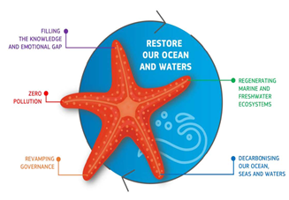
European Mission ‘Restore our Ocean and Waters by 2030’ Systemic path to restoration of the health of the ocean & waters as recommended by the Mission Board in its Starfish report
Notes:
The Mission Ocean and its implementation is inspired by the report of the Mission Board chaired by Mr. Pascal Lamy.
Our ambition is to deliver on the European Green Deal by Mission Ocean and waters supporting the development of a systemic path to restore our ocean and water by 2030.

Slide 4
Mission Restore our ocean and waters by 2030: objectives and targets
Protect and restore marine and freshwaters ecosystems and biodiversity
Protect at least 30% and strictly protect 10% EU’s sea areas
Prevent and eliminate pollution of our oceans, Seas and waters
Make the blue economy carbon- neutral and circular
Net zero maritime emissions
Zero carbon aquaculture,
Reduce by at least 50% plastic litter
Restore 25.000 km free flowing rivers
Marine nature restoration targets (incl. degraded seabeds, coastal ecosystems)
Reduce by at least 30% microplastics
Reduce by at least 50% nutrient losses, chemical pesticides
Low carbon multipurpose use of marine space
ENABLERS: - Digital Ocean and waters knowledge System
- Public mobilization and engagement
Notes:
ELISABETTA
This Mission’s strategic objective is to restore the health of our ocean and waters by 2030. Here you can see the structure of our Mission with specific objectives, enablers and targets, which are aligned to the different strategies of the EU Green Deal
The Mission will “protect and restore marine and freshwater ecosystems and biodiversity”. The targets to achieve this objective, are in line with the Biodiversity Strategy and the upcoming Restoration Law
The Mission will "prevent and eliminate pollution of our ocean, seas and waters", in line with the EU Action Plan Towards Zero Pollution for Air, Water and Soil and its relevant targets.
The Mission will "make the blue economy carbon-neutral and circular", in line with the proposed European Climate Law and the holistic vision enshrined in the Sustainable Blue Economy Strategy.
To support all Mission objectives, we will put in place two cross-cutting enablers:
1. A digital ocean and waters knowledge system, which will:
> Prepare a Digital Twin of the Ocean building on and extend existing and planned European infrastructures and services such as Copernicus and EMODet.
2. Public mobilisation and engagement, by mobilising on a broad basis, engaging the European public to help catalyse the necessary transformative change for the restoration of the ocean and waters.

Slide 5
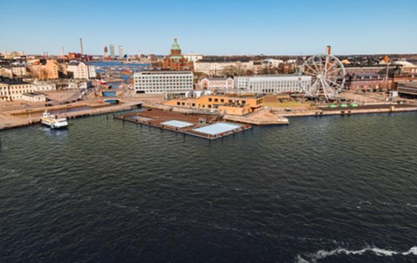
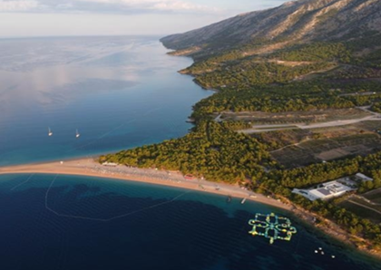
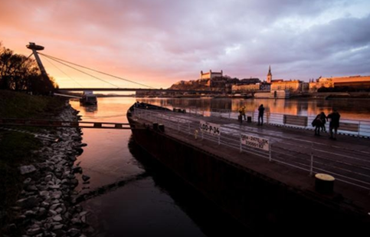
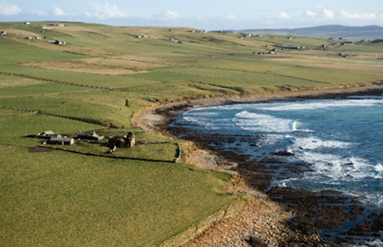
Mission lighthouses: sites to develop, pilot, demonstrate, and deploy the Mission outcomes across EU seas and river basins
Baltic and North Sea basin
Mediterranean sea basin
Make the blue economy carbon- neutral and circular
Prevent and eliminate pollution of our ocean, seas and waters
Danube river basin
Atlantic & Arctic basin
Protect and restore marine and freshwaters ecosystems and biodiversity

Slide 6
Mission Ocean, seas and waters work programme under Horizon Europe – main features
Follows the impact-driven logic of Horizon Europe
Supports major EU policy objectives, e.g.: the EU Biodiversity Strategy 2030, the Action Plan toward Zero pollution, the COM on a Sustainable Blue Economy
Participation open to any MSs and ACs as well as any third countries . Special focus on:
«lighthouses»: hubs for the development and deployment of transformative innovations (technological, social, business, governance) in 4 main basins complemented by cross-basin activities
innovation actions to test and demonstrate the technical, economic and/or societal viability of innovatiove solutions in a (near to) operational environment
Concept of “associated regions” included in all relevant IAs: Involvement of at least 5 «associated regions» to showcase the feasibility, replicability and scale-up of innovative solutions
Citizens’ engagement and users’ involvement
WP 2022 Indicative budget 2022: EUR 117.9 million - Call deadline: 27 September 2022

Slide 7
Mission work programme 2022
European Blue Parks
Danube river basin lighthouse
Atlantic & Arctic sea basin lighthouse
Protection and restoration solutions for degraded coastal and marine habitats (IA, 17million EUR)
Protection and restoration of wetlands, flood plains, coastal wetlands and salt marshes and their biodiversity (IA, 17 million EUR)
Mission Climate adaptation and Mission Ocean and waters - Joint demonstration for coastal resilience in the Arctic and Atlantic sea basin (IA , 20 million EUR)

Slide 8
Mission work programme 2022
Baltic & North sea basin lighthouse
Mediterranean sea basin lighthouse
Actions to prevent, minimise and remediate chemical pollution (IA, 17 million EUR)
Bringing sustainable algae-based products and solutions to the market (IA, 17 million EUR)

Slide 9
Mission work programme 2022
Cross-basin topics
Prevent and eliminate litter, plastics and microplastics: Innovative solutions for waste-free European rivers (IA, 10 million EUR)
Marine litter and pollution – Smart and low environmental impact fishing gears (IA, 10 million EUR)

Slide 10
Mission work programme 2022
Digital Ocean & Water knowledge system
Integration of biodiversity monitoring data into the Digital Twin Ocean (IA, 10 million EUR)
Enabling actions: Citizen mobilisation & engagement; studies
Student and school activities for the promotion of education on ‘blue’ sustainability and the protection of marine and freshwater ecosystems (CSA, 3 million EUR)
Towards local community-driven business models: regenerative ocean farming (CSA, 3 million EUR)
Towards a European e-DNA library of marine and freshwater species (CSA, 2 million EUR)

Slide 11
A joint commitment to Restoring our Ocean and Waters
MISSION IMPLEMENTATION CHARTER
Join forces for a transformational change for a healthy ocean and waters, thus contributing to the EU Green Deal objectives
Establish a simple, inclusive, efficient and inspirational framework to enhance cooperation to deliver on Mission objectives
Open to any public or private interested parties
Notes:
ANDREEA

Slide 12
Mission Charter
Developed by the Commission in close cooperation with the MS/ACs, regions and key stakeholders willing to contribute to the implementation of the Mission
Sets the direction when defining initiatives, programmes, actions and common agendas for restoring our ocean and waters
Non-binding engagement
Expected by June 2022 and launched at the UN Ocean Conference on 27 June-1 July.
MISSION
CHARTER
Notes:
The lighthouses will be established through an implementation charters endorsed by relevant Member States, the European Commission and key partners.
Any Mission partner who is willing to sign up to the Mission objectives and capable of contributing to its success will be encouraged to endorse the charter
The charter will be non-binding, but will commit the partners to cooperating, aligning and mobilising resources and activities.
Through this charter, we ask you here, today, to cooperate and align resources to achieve the Mission objectives. This approach will benefit from your and our existing work and build on existing structures.
There will be one overall Mission charter, plus basin-specific commitments for each lighthouse.
Member State involvement is crucial:
To ensure involvement of ALL MSs and ACs at national and regional level and follow-up those lagging behind → we need to co-design suitable measures
To support regions involvement in Mission projects from early stages, including “associated regions” to replicate/deploy innovative solutions and build capacities across EU → we need to trigger all tools available to deploy innovative solutions

Slide 13
MISSION IMPLEMENTATION CHARTER
Mission Charter areas of actions you may
want to contribute to:
Research and innovation: mobilise your programmes, instruments and resources for healthy ocean and waters and a sustainable blue economy
Upscaling, deployment and replication of solutions: support well-functioning innovation ecosystems and its different components: finance, investments, infrastructures, talents, regulations, …
Evidence-based knowledge and data: generate, use and share authoritative knowledge and data in marine, maritime and biodiversity domains in line with FAIR principles and feed the Mission Ocean Knowledge System and Mission baseline studies
Outreach, public mobilisation and engagement: promote involvement and citizen-led initiatives; ocean literacy; awareness raising and participatory approaches
Establishment of Communities of practice to serve as fora for co-design, exchanges of experiences, tools and good practice, to coordinate actions and to take stock of progress
Notes:
In preparation of this workshop, we have sent you the Mission Implementation Plan and a first draft charter. We want to use today as a first step of co-creating the charter with you, starting from the question on how each of us can contribute to the Mission Implementation Plan, building on own existing and upcoming relevant programmes, initiatives and resources.
The charter should outline the key elements that will be necessary to restore the health of our ocean and waters by 2030. That is:
Mobilisation of research and innovation
Access to knowledge
Public mobilisation
Mobilisation
Convene a community
But we would would like to hear from you which of your networks, instruments and available tools you are willing to mobilise to achieve the targets of this Mission that brings tangible change for this goal.
In the relevant sea/river basin, we will prioritise the objective as guided by the Mission “Restore our Ocean and waters by 2030” and we will build on the existing structures. However, by 2030 gradually we will address all of the three interlinked specific objectives across all basins.

Slide 14
#MissionOcean
#EUmissions
#HorizonEU
EU Mission: Restore our Ocean and Waters | European Commission (europa.eu)

