Slide 1
The Citizens, Equality, Rights and Values programme 2021-2027

Slide 2
Overview
Citizens, Equality, Rights and Values programme
Current and upcoming calls for proposals
How to apply?

Slide 3
What are « EU values » ?
Article 2 of the Treaty on the European Union
The Union is founded on the values of respect for human dignity, freedom, democracy, equality, the rule of law and respect for human rights, including the rights of persons belonging to minorities.
These values are common to the Member States in a society in which pluralism, non-discrimination, tolerance, justice, solidarity and equality between women and men prevail.
Notes:
In accordance with Article 2 of the Treaty on the European Union, ‘the Union is founded on the values of respect for human dignity, freedom democracy, equality, the rule of law and the respect for human rights, including the rights of persons belonging to minorities. These values are common to the Member States in a society where pluralism, non-discrimination, tolerance, justice, solidarity and equality between women and men prevail’.
These values are the heart of the CERV programme

Slide 4
Citizens, Equality, Rights and Values
Budget: 1.55 billion euro
Notes:
A major breakthrough is the increase in budget. The CERV programme will benefit for total budget of 152 million euro. This is more than double than the initial 642 million euro proposed, as during negotiations co-legislators agreed for a top-up of 912 million euro, available for 2022 onwards. (IN CURRENT PRICES)
Please, bear in mind this additional allocation to the programme comes from fines and is not fixed but will be calculated annually.
We estimated an annual allocation between 118 and 157 million euro, where 2027 will serve as a year to balance, to have a total of 912 million euro in six years.

Slide 5
What are the objectives ?
To protect and promote rights and values as enshrined in the EU Treaties and the EU Charter
by supporting civil society organisations and other stakeholders active at local, regional, national and transnational level,
by encouraging civic and democratic participation, in order to sustain and further develop open, rights-based, democratic, equal and inclusive societies based on the rule of law
Union values strand
Equality, Rights and Gender Equality strand
Daphne strand
Citizens' engagement and participation strand

Slide 6
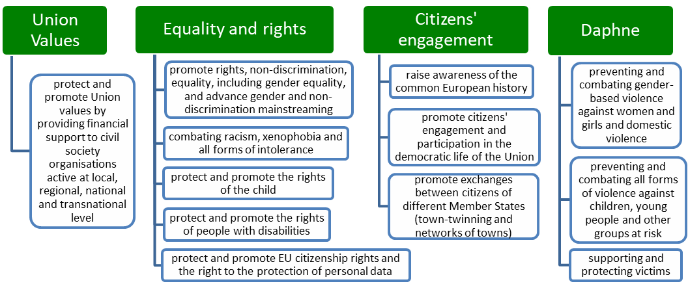
CERV Programme – Four strands

Slide 7
What is new in CERV
Union Values (Re-granting)
New call with 50 million euro (2021)
National Contact Points
27 national relays (so far 19 appointed)
Multi-year work programme
2021-2 Work Programme with 292 million euro
Re-granting scheme to support small and grassroots NGOs
assistance to applicants, stakeholders and beneficiaries
Providing guidance and practical information
Merging of two programmes
Rights, Equality and Citizenship 2014-2020 – combating racism, gender-based violence,…etc
Europe for Citizens 2014-2020 – citizen engagement and participation, town-twinning, European remembrance
Advanced planning for all calls
Bigger transparency and earlier information for stakeholders
→ multi-year priorities
→ Soon for framework partners (5,6 million euro in 2022)
2,5 – 4,5 million euro per organisation

Slide 8
Which actions?
Training activities, capacity building, mutual learning, workshops, experts’ meetings, conferences
Awareness-raising and dissemination activities, media campaigns
Analytical activities, such as studies, researches, surveys and evaluations
Support for European networks, civil society
Notes:
The Programme shall finance the following types of actions:
training activities, capacity building, mutual learning, workshops, experts' meetings and conferences;
awareness-raising and dissemination activities, such as the identification of, and exchanges concerning, good practices, innovative approaches and experiences; media campaigns, including in the online media, information campaigns, the compilation and publication of materials to disseminate information about the Programme and its results; the development, operation and maintenance of systems and tools using information and communication technologies;
analytical activities, such as the collection of data and statistics; the development of common methodologies and, where appropriate, indicators or benchmarks; studies, researches, analyses and surveys; evaluations; the elaboration and publication of guides, reports and educational material;
support for main actors whose activities contribute to the implementation of the objectives of the Programme, such as support for NGOs in the implementation of actions with European added value, support for key European actors, European-level networks.

Slide 9
Participation to the Programme
WHO
CSO are the main beneficiaries, both national and transnational as well as grassroots ( union values strand)
Public and private entities e.g. ministries, towns
Profit-oriented and international organisations: limited access (depending also on the call for proposals)
Notes:
At present, the countries participating in the Programme are: EU Member States,
Organisations which are profit-oriented must submit applications in partnership with public entities or private non-profit organisations;

Slide 10
Funding methods
Grants
Action grants - funding for national or transnational projects
Operating grants - operating costs for EU level NGOs and similar bodies
Procurement – service contract tenders e.g. EU studies, EU conferences, EU campaigns
Prize – financial contribution given as a reward following a contest
Notes:
The Funds are being implemented in 3 ways: grants, procurement, or by awarding a prize.
Grants are financial contributions by the Commission in order to finance:
an action intended to help achieve a Union policy objective - action grants;
the functioning of a body which has an objective forming part of, and supporting, a Union policy - operating grants . The award of a grant follows, in general, a call for proposals’ procedure.
Procurement is the acquisition of a service by the Commission from an economic operator, which is selected following a call for tenders’ procedure.
.
Prizes are financial contributions given by the Commission as a reward following a contest. They shall promote the achievement of policy objectives of the Union.

Slide 11
Upcoming CERV calls for proposals Equality and rights strand
CERV Calls for proposals | Call reference | Budget | Opening | Deadline
Rromote equality and to fight against racism, xenophobia and discrimination | CERV-2022-EQUAL | 12,2M | 15 Dec21 | 24/02/2022
Restricted to National Roma Contact Points | CERV-2022-NRCP | 1,9M | 15 Dec21 | 3/03/2022
Promote gender equality | CERV-2022-GE | 6,8M | 15 Dec21 | 16/03/2022
Protect and promote the rights of the child | CERV-2022-CHILD | 3M | 15 Dec21 | 18/05/2022
National Data Protection Authorities | CERV-2021-DATA | 1,8M | 6 May21 | 08/12/2021

Slide 12
Upcoming CERV calls for proposals Citizens’ engagement and participation strand
CERV Calls for proposals | Call reference | Budget | Opening | Deadline
European remembrance | CERV-CITIZENS-2022-REM | 8M | 30/11/21 | 24/03/2022
Citizens' engagement and participation | CERV-CITIZENS-2022-CIV | 17,4M | 28/10/21 | 10/02/2022
Town-Twinning and Networks of Towns | CERV-CITIZENS-2022-TOWN | 11M | 16/11/21 | 24/03/2022

Slide 13
Upcoming CERV calls for proposals Daphne strand
CERV Calls for proposals | Call reference | Budget | Opening | Deadline
Prevent and combat gender-based violence and violence against children | CERV-2022-DAPHNE | 30,5M | 15/12/21 | 12/04/2022

Slide 14
Upcoming CERV calls for proposals Values strand
CERV Calls for proposals | Call reference | Budget | Opening | Deadline
Protecting and promoting Union values | CERV-2021-CITIZENS VALUES | 51 M | Q4 2021
Promote capacity building and awareness on the EU Charter of Fundamental Rights and activities on strategic litigation relating to democracy, rule of law and fundamental rights breaches | CERV-2022-CHAR-LITI | 2 M | 28/10/21 | 24/02/2022
Operating grants to Framework Partners active in the areas of Union values | CERV-2022-OG-SGA | 32,5 M | Q3 2022
Notes:
Both calls – are first time calls

Slide 15
Overview
Citizens, Equality, Rights and Values programme
Current and upcoming calls for proposals
How to apply?

Slide 16
Call for proposals to promote equality and to fight against racism, xenophobia and discrimination
KEY CALL FACTS
15 December 2021 – 24 February 2022 (10 weeks)
12,2 million euro with min. single grant of 75.000 euro
Only consortia of min. 2 organisations
EU provides 90% co-funding
Only organisations established in the EU
Project duration max 2 years

Slide 17
Call for proposals to promote equality and to fight against racism, xenophobia and discrimination
Timetable and deadlines (indicative)
Call opening: | 15 December 2021
Deadline for submission: | 24 February 2022 – 17:00:00 CET (Brussels)
Evaluation: | February – June 2022
Information on evaluation results: | June-July 2022
GA signature: | September-October 2022

Slide 18
Call for proposals to promote equality and to fight against racism, xenophobia and discrimination
Racism and discrimination
Hate speech and Hate crime
EU Roma strategic framework
Diversity management
promote diversity and inclusion in the workplace, with regard in particular to the six grounds of discrimination
LGBTIQ
LGBTIQ Equality Strategy 2020-2025
actions that seek to tackle gender and sexuality stereotypes in and through education
Online hate speech
Public authorities
EU Strategy on combating antisemitism
empower the capacity of civil society organisations
ensure the existence of Diversity Charters
Reporting hate speech content to the IT Companies
Multi-stakeholder initiatives on tackling the societal challenges of hate speech online.
Knowledge about ecosystems of hate speech online and responses to Violent Right Wing Extremist (VRWE) ideologies and groups
public authorities (national, regional and local level) to improve implementation on the
the Racial Equality Directive,
the Framework Decision on combating racism and xenophobia and
Recommendation C(2018) 3850 on standards for equality bodies
focus is on the LGBTIQ people, in the most vulnerable situations
EU Anti-racism action plan
EUR 1 000 000
EUR 1 500 000
EUR 1 500 000
EUR 7 7400 000
provide support to rainbow families
EUR 500 000

Slide 19
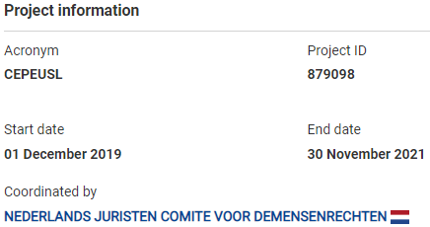
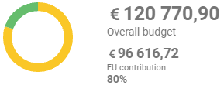
Call for proposals to promote equality and to fight against racism, xenophobia and discrimination
Project example
Combatting Ethnic Profiling in the EU through Strategic Litigation by the Netherlands Jurists Committee for Human Rights

Slide 20
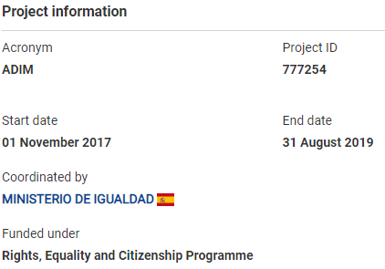
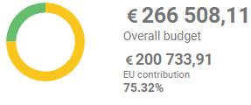
Call for proposals to promote equality and to fight against racism, xenophobia and discrimination
Project example
Advancing in LGBT Diversity Management in the Public and Private Sector by the Spanish Ministry of Equality

Slide 21
Success rates?
219 proposals
32 awarded
15% success rate

Slide 22
Daphne
Prevent and combat:
gender-based violence against women and girls, domestic violence
violence against children, young people, other groups at risk (LGBTQI persons & persons with disabilities...)
Support and protect all direct and indirect victims of such violence
Daphne
Notes:
Within the general objective set out in Article 2(1) and within the specific objective set out in point (d) of Article 2(2), the Programme shall focus on:
(1) preventing and combating at all levels all forms of gender-based violence against women and girls and domestic violence, including by promoting the standards laid down in the Council of Europe Convention on preventing and combating violence against women and domestic violence (the Istanbul Convention);
(2) preventing and combating all forms of violence against children, young people and other groups at risk, such as LGBTIQ persons and persons with disabilities;
(3) supporting and protecting all direct and indirect victims of the forms of violence referred to in points (1) and (2), such as the victims of domestic violence perpetrated within the family or within intimate relationships, including children orphaned as a result of domestic crimes, and supporting and ensuring the same level of protection throughout the Union for victims of gender-based violence.

Slide 23
Daphne
CERV-2022-DAPHNE: € 30,5 million – deadline: 12 April 2022
Priorities
Large-scale and long-term transnational actions (€12 million)
Combating and preventing violence linked to harmful practices (€ 6 million)
Primary prevention of gender-based violence (€ 7 million)
National data collection on violence against children (€ 3 million)
Prevent and support child victims of violence (€ 2,5 million)
Notes:
Call for proposals to prevent and combat gender-based violence and violence against children
The budget available for this call is equal to € 30,5 million in 2022.
2022
1. Large-scale and long-term transnational actions to tackle gender-based violence - € 12 million in 2022 and transnational grants between € 1 million and € 2 million
In line with the Gender Equality Strategy, this priority aims to support the development of large-scale, integrated actions to combat gender-based violence, and achieve long-term and structural changes with a wide geographical coverage.
In particular, the actions shall focus on:
harmful practices: tackling female genital mutilation and forced sterilisation, early and forced marriage, 'honour-related violence' and other harmful practices against women and girls;
domestic violence: increasing awareness of and access to support services for (potential) victims, strengthening gender-specific responses to domestic violence (including for witnesses of domestic violence)], through capacity-building and multi-disciplinary strengthened cooperation and coordination among relevant actors;
online violence targeting women and girls: tackling gender-based cyber violence, such as incitement to violence, online stalking, non-consensual image sharing, extortion with the use of sexual imagery ('sextortion'), sexual or gendered online harassment and bullying, grooming, etc;
violence and harassment in the world of work: tackling physical and psychological offline and online violence or harassment in work contexts by, in particular, preventing such unwanted behaviours, encouraging the development and implementation of remedies and victim support mechanisms], and the development of relevant tools, guidance, education and training;
gender stereotypes: preventing gender-based violence by tackling prejudices and gender stereotypes, in particular those related to masculinities, norms, attitudes and behaviours that encourage, condone or minimise violence], as well as by providing women and men, girls and boys, in all their diversity, with the tools to call out and stand up to violence through empowerment and bystander intervention programmes.
Proposals will have to develop a long-term programme of intervention in view of achieving changes in attitudes and behaviour, guaranteeing impact and reaching out to a large number of participants in different geographical areas of the EU and covered by the programme.
2. Combating and preventing violence linked to harmful practices - € 6 million in 2022 and grants up to € 1 million
This entails combating, raising awareness and preventing violence linked to harmful practices such as female genital mutilation, forced or early-age marriage or forced sexual relationships, so-called 'honour crimes' committed against women, young people and children. [It includes the strengthening of public services, prevention and support measures, capacity building of professionals and victim-centred access to justice.]
3. Primary prevention of gender-based violence - € 7 million in 2022 and grants up to € 1 million
The focus of this priority is on primary prevention, in particular changing social norms and behaviour, in order to end tolerance of all forms of gender-based violence. This includes specific and practical awareness-raising, education and training activities to tackle prejudices and gender stereotypes and norms that encourage, condone or minimise violence, as well as to provide women and men with the tools to call out and stand up to violence through empowerment and bystander intervention programmes. Any form of gender-based violence can be covered under this priority. Proposals must explain which social norms and behaviours they aim to address and justify how activities encouraging or discouraging these attitudes and behaviours will directly contribute to the prevention of gender-based violence.]
4. Supporting and improving national data collection on violence against children - € 3 million in 2022
Collection of data on violence against children is very fragmented. There are gaps at all levels, making the response to violence more difficult. This priority aims to foster efforts towards more sustainable and comprehensive data collection at local and/or national level.
5. Strengthening responses that prevent and support child victims of violence by reinforcing child protection systems at national and local level - € 2,5 million in 2022
[An effective response to violence (in all its forms) is only possible when it is well coordinated among all relevant stakeholders. Too often, services work in silos, with little referral between relevant services, or lack of follow-up to cases in the long term. Prevention activities are separated from protection and support to victims. The objective of this priority is to contribute to systemic changes at national level, and ultimately create integrated child protection systems, for a more effective prevention and protection of victims.]

Slide 24
Daphne
CERV-2022-DAPHNE: formal requirements
Organisations which are profit-oriented must submit applications in partnership with public entities or private non-profit organisations.
The project can be either national or transnational (except for Priority 1 – only transnational).
The application must involve at least two organisations (applicant and partner).
The EU grant applied for cannot be lower than € 75 000 (€ 1 million for Priority 1)
The EU grant applied for cannot be higher than:
€ 2 million for Priority 1
€ 1 million for Priorities 2 and 3
No formal limit for Priorities 4 and 5
Duration of projects should range between 12 and 24 months (36 months for Priority 1).
Notes:
Call for proposals to prevent and combat gender-based violence and violence against children
The budget available for this call is equal to € 30,5 million in 2022.
2022
1. Large-scale and long-term transnational actions to tackle gender-based violence - € 12 million in 2022 and transnational grants between € 1 million and € 2 million
In line with the Gender Equality Strategy, this priority aims to support the development of large-scale, integrated actions to combat gender-based violence, and achieve long-term and structural changes with a wide geographical coverage.
In particular, the actions shall focus on:
harmful practices: tackling female genital mutilation and forced sterilisation, early and forced marriage, 'honour-related violence' and other harmful practices against women and girls;
domestic violence: increasing awareness of and access to support services for (potential) victims, strengthening gender-specific responses to domestic violence (including for witnesses of domestic violence)], through capacity-building and multi-disciplinary strengthened cooperation and coordination among relevant actors;
online violence targeting women and girls: tackling gender-based cyber violence, such as incitement to violence, online stalking, non-consensual image sharing, extortion with the use of sexual imagery ('sextortion'), sexual or gendered online harassment and bullying, grooming, etc;
violence and harassment in the world of work: tackling physical and psychological offline and online violence or harassment in work contexts by, in particular, preventing such unwanted behaviours, encouraging the development and implementation of remedies and victim support mechanisms], and the development of relevant tools, guidance, education and training;
gender stereotypes: preventing gender-based violence by tackling prejudices and gender stereotypes, in particular those related to masculinities, norms, attitudes and behaviours that encourage, condone or minimise violence], as well as by providing women and men, girls and boys, in all their diversity, with the tools to call out and stand up to violence through empowerment and bystander intervention programmes.
Proposals will have to develop a long-term programme of intervention in view of achieving changes in attitudes and behaviour, guaranteeing impact and reaching out to a large number of participants in different geographical areas of the EU and covered by the programme.
2. Combating and preventing violence linked to harmful practices - € 6 million in 2022 and grants up to € 1 million
This entails combating, raising awareness and preventing violence linked to harmful practices such as female genital mutilation, forced or early-age marriage or forced sexual relationships, so-called 'honour crimes' committed against women, young people and children. [It includes the strengthening of public services, prevention and support measures, capacity building of professionals and victim-centred access to justice.]
3. Primary prevention of gender-based violence - € 7 million in 2022 and grants up to € 1 million
The focus of this priority is on primary prevention, in particular changing social norms and behaviour, in order to end tolerance of all forms of gender-based violence. This includes specific and practical awareness-raising, education and training activities to tackle prejudices and gender stereotypes and norms that encourage, condone or minimise violence, as well as to provide women and men with the tools to call out and stand up to violence through empowerment and bystander intervention programmes. Any form of gender-based violence can be covered under this priority. Proposals must explain which social norms and behaviours they aim to address and justify how activities encouraging or discouraging these attitudes and behaviours will directly contribute to the prevention of gender-based violence.]
4. Supporting and improving national data collection on violence against children - € 3 million in 2022
Collection of data on violence against children is very fragmented. There are gaps at all levels, making the response to violence more difficult. This priority aims to foster efforts towards more sustainable and comprehensive data collection at local and/or national level.
5. Strengthening responses that prevent and support child victims of violence by reinforcing child protection systems at national and local level - € 2,5 million in 2022
[An effective response to violence (in all its forms) is only possible when it is well coordinated among all relevant stakeholders. Too often, services work in silos, with little referral between relevant services, or lack of follow-up to cases in the long term. Prevention activities are separated from protection and support to victims. The objective of this priority is to contribute to systemic changes at national level, and ultimately create integrated child protection systems, for a more effective prevention and protection of victims.]

Slide 25
Daphne
Success rates – DAPHNE 2021 call for proposals (17,7 € million)
In 2021 we had 2 priorities:
Early detection, prevention and protection of and/or support to women, children, young people and LGBTIQ victims or potential victims of violence, with specific attention paid to situations emerging from the COVID-19 pandemic
Preventing gender-based violence by addressing masculinities and the engagement of men and boys
Number of proposals submitted: 154
Number of eligible proposals: 149
Priority 1 - 109 proposals => 30 proposals awarded (success rate 27%)
Priority 2 - 40 proposals => 10 proposals awarded (success rate 25%)
Notes:
Call for proposals to prevent and combat gender-based violence and violence against children
The budget available for this call is equal to € 30,5 million in 2022.
2022
1. Large-scale and long-term transnational actions to tackle gender-based violence - € 12 million in 2022 and transnational grants between € 1 million and € 2 million
In line with the Gender Equality Strategy, this priority aims to support the development of large-scale, integrated actions to combat gender-based violence, and achieve long-term and structural changes with a wide geographical coverage.
In particular, the actions shall focus on:
harmful practices: tackling female genital mutilation and forced sterilisation, early and forced marriage, 'honour-related violence' and other harmful practices against women and girls;
domestic violence: increasing awareness of and access to support services for (potential) victims, strengthening gender-specific responses to domestic violence (including for witnesses of domestic violence)], through capacity-building and multi-disciplinary strengthened cooperation and coordination among relevant actors;
online violence targeting women and girls: tackling gender-based cyber violence, such as incitement to violence, online stalking, non-consensual image sharing, extortion with the use of sexual imagery ('sextortion'), sexual or gendered online harassment and bullying, grooming, etc;
violence and harassment in the world of work: tackling physical and psychological offline and online violence or harassment in work contexts by, in particular, preventing such unwanted behaviours, encouraging the development and implementation of remedies and victim support mechanisms], and the development of relevant tools, guidance, education and training;
gender stereotypes: preventing gender-based violence by tackling prejudices and gender stereotypes, in particular those related to masculinities, norms, attitudes and behaviours that encourage, condone or minimise violence], as well as by providing women and men, girls and boys, in all their diversity, with the tools to call out and stand up to violence through empowerment and bystander intervention programmes.
Proposals will have to develop a long-term programme of intervention in view of achieving changes in attitudes and behaviour, guaranteeing impact and reaching out to a large number of participants in different geographical areas of the EU and covered by the programme.
2. Combating and preventing violence linked to harmful practices - € 6 million in 2022 and grants up to € 1 million
This entails combating, raising awareness and preventing violence linked to harmful practices such as female genital mutilation, forced or early-age marriage or forced sexual relationships, so-called 'honour crimes' committed against women, young people and children. [It includes the strengthening of public services, prevention and support measures, capacity building of professionals and victim-centred access to justice.]
3. Primary prevention of gender-based violence - € 7 million in 2022 and grants up to € 1 million
The focus of this priority is on primary prevention, in particular changing social norms and behaviour, in order to end tolerance of all forms of gender-based violence. This includes specific and practical awareness-raising, education and training activities to tackle prejudices and gender stereotypes and norms that encourage, condone or minimise violence, as well as to provide women and men with the tools to call out and stand up to violence through empowerment and bystander intervention programmes. Any form of gender-based violence can be covered under this priority. Proposals must explain which social norms and behaviours they aim to address and justify how activities encouraging or discouraging these attitudes and behaviours will directly contribute to the prevention of gender-based violence.]
4. Supporting and improving national data collection on violence against children - € 3 million in 2022
Collection of data on violence against children is very fragmented. There are gaps at all levels, making the response to violence more difficult. This priority aims to foster efforts towards more sustainable and comprehensive data collection at local and/or national level.
5. Strengthening responses that prevent and support child victims of violence by reinforcing child protection systems at national and local level - € 2,5 million in 2022
[An effective response to violence (in all its forms) is only possible when it is well coordinated among all relevant stakeholders. Too often, services work in silos, with little referral between relevant services, or lack of follow-up to cases in the long term. Prevention activities are separated from protection and support to victims. The objective of this priority is to contribute to systemic changes at national level, and ultimately create integrated child protection systems, for a more effective prevention and protection of victims.]

Slide 26
Daphne
Example of selected proposal – DAPHNE 2021 call for proposals
Proposal Acronym: ACT4EC
Title: Awareness-raising and Capacity-building Toolkit for the Protection of all European Children
Total Cost: 496,640.50 € / Grant Requested: 446,273.00 €
Partners:
STICHTING NEDERLANDS COMITE UNICEF
Augeo Academy B.V.
Centro pa Desaroyo di Aruba
UNIVERSITY OF CURACAO DR MOISES DA COSTA GOMEZ
The project improves the existing national mechanisms for the early detection, prevention and protection of violence against children by raising the awareness and building the capacity of professionals working with and for children in the Kingdom of the Netherlands, particularly in Aruba and Curaçao.
Notes:
Call for proposals to prevent and combat gender-based violence and violence against children
The budget available for this call is equal to € 30,5 million in 2022.
2022
1. Large-scale and long-term transnational actions to tackle gender-based violence - € 12 million in 2022 and transnational grants between € 1 million and € 2 million
In line with the Gender Equality Strategy, this priority aims to support the development of large-scale, integrated actions to combat gender-based violence, and achieve long-term and structural changes with a wide geographical coverage.
In particular, the actions shall focus on:
harmful practices: tackling female genital mutilation and forced sterilisation, early and forced marriage, 'honour-related violence' and other harmful practices against women and girls;
domestic violence: increasing awareness of and access to support services for (potential) victims, strengthening gender-specific responses to domestic violence (including for witnesses of domestic violence)], through capacity-building and multi-disciplinary strengthened cooperation and coordination among relevant actors;
online violence targeting women and girls: tackling gender-based cyber violence, such as incitement to violence, online stalking, non-consensual image sharing, extortion with the use of sexual imagery ('sextortion'), sexual or gendered online harassment and bullying, grooming, etc;
violence and harassment in the world of work: tackling physical and psychological offline and online violence or harassment in work contexts by, in particular, preventing such unwanted behaviours, encouraging the development and implementation of remedies and victim support mechanisms], and the development of relevant tools, guidance, education and training;
gender stereotypes: preventing gender-based violence by tackling prejudices and gender stereotypes, in particular those related to masculinities, norms, attitudes and behaviours that encourage, condone or minimise violence], as well as by providing women and men, girls and boys, in all their diversity, with the tools to call out and stand up to violence through empowerment and bystander intervention programmes.
Proposals will have to develop a long-term programme of intervention in view of achieving changes in attitudes and behaviour, guaranteeing impact and reaching out to a large number of participants in different geographical areas of the EU and covered by the programme.
2. Combating and preventing violence linked to harmful practices - € 6 million in 2022 and grants up to € 1 million
This entails combating, raising awareness and preventing violence linked to harmful practices such as female genital mutilation, forced or early-age marriage or forced sexual relationships, so-called 'honour crimes' committed against women, young people and children. [It includes the strengthening of public services, prevention and support measures, capacity building of professionals and victim-centred access to justice.]
3. Primary prevention of gender-based violence - € 7 million in 2022 and grants up to € 1 million
The focus of this priority is on primary prevention, in particular changing social norms and behaviour, in order to end tolerance of all forms of gender-based violence. This includes specific and practical awareness-raising, education and training activities to tackle prejudices and gender stereotypes and norms that encourage, condone or minimise violence, as well as to provide women and men with the tools to call out and stand up to violence through empowerment and bystander intervention programmes. Any form of gender-based violence can be covered under this priority. Proposals must explain which social norms and behaviours they aim to address and justify how activities encouraging or discouraging these attitudes and behaviours will directly contribute to the prevention of gender-based violence.]
4. Supporting and improving national data collection on violence against children - € 3 million in 2022
Collection of data on violence against children is very fragmented. There are gaps at all levels, making the response to violence more difficult. This priority aims to foster efforts towards more sustainable and comprehensive data collection at local and/or national level.
5. Strengthening responses that prevent and support child victims of violence by reinforcing child protection systems at national and local level - € 2,5 million in 2022
[An effective response to violence (in all its forms) is only possible when it is well coordinated among all relevant stakeholders. Too often, services work in silos, with little referral between relevant services, or lack of follow-up to cases in the long term. Prevention activities are separated from protection and support to victims. The objective of this priority is to contribute to systemic changes at national level, and ultimately create integrated child protection systems, for a more effective prevention and protection of victims.]

Slide 27
Call for proposals on protecting and promoting Union Values
Notes:
This is the first time call, there were no similar calls in the previous MFF.

Slide 28
Main features of the call
51 000 000€ for the first call
EACEA
Intermediary
Intermediary
Intermediary
CSO
CSO
CSO
CSO
CSO
Intermediary
CSO
CSO
CSO
CSO
CSO
CSO
CSO
CSO
CSO
CSO
CSO
Intermediary
CSO
CSO
CSO
CSO
Launch three calls for proposals during the period 2021-2027 , 3-years action grants
Build knowledge and capacity and regrant
Protect, promote and raise awareness on rights and values
Notes:
The objective of the call is to reach out to the local level, to the small grassroots organisations. We plan to do it with a help of intermidiaries. So the call is to select the intermidiaries, who then will work with small civil society organisations.
This is a cascading call.

Slide 29
The role of intermediaries
support to the preparation and implementation of activities of CSOs,
train and build the capacity and sustainability of CSOs,
policy development and engagement of CSOs,
promote and facilitate networking.
Build knowledge and capacity
and regrant

Slide 30
Overview
Citizens, Equality, Rights and Values programme
Current and upcoming calls for proposals
How to apply?

Slide 31
Action grants
The list of calls for proposals can be found at
Funding & Tender Opportunities
Notes:
Closed, ongoing and forthcoming

Slide 32
How to apply
Go to the Funding & tenders opportunities portal
Funding & tenders (europa.eu)
Read carefully the text of the calls for proposals
e.g. call document call-fiche_cerv-2021-equal_en.pdf (europa.eu)
Questions: EC-CERV-CALLS@ec.europa.eu
For IT related questions: here
Subscribe to DG Justice newsletter on funding opportunies: here.
Notes:
If you wish to apply, it is worth starting with

Slide 33
Proposal structure
Part A – online form
General Information, participants and contacts, budget
Part B – document (max. 45 pages)
Description of the project and applicant organisation, work packages and activities
Part C – online form
Data and indicators (number of participants, disaggregated by sex)
Annex 1 – CVs key staff applicant and partners (max. 100 pages)
Annex 2 – Annual Activity Report coordinator
Annex 3 – List of key previous EU projects of the coordinator for the last 4 years
Annex 4 – Child protection policy (if contact with children)
Annex 5 – Letters of support (optional)
Notes:
The application for CERV programme calls consists of 3 main parts: A, B and C, and also of a number of annexes.

Slide 34
Part B
Project summary
Relevance: objectives, needs analysis and EU added value
Quality: methodology, consortium, staff, management, monitoring and evaluation, cost-effectiveness, risks, work packages and activities, timetable, subcontract
Impact: impact, communication, sustainability
Other: Ethics and EU values
Declarations
Notes:
The main elements of the part B are the one on the screen.
The sections of the application of the part B are cross-referenced here with the award criteria.
[Human effort per month: as 1 year = 12 months = 220 working days, therefore 18.33 working days per month.
e.g. one year of full time employment of one staff member = 12 person-months, so 24 full working days for one person = 24/18.33 = 1.31 person-months
e.g. each of the three partners employs a project manager working half of their time on the project for its entire duration of two years → 3 people working 6 months every year on the project = 12 person months per project partner → a total of 36 person months.]

Slide 35
Particular points of attention
Gender equality perspective
- needs assessment
- project team
- sub-contractor
- monitoring and evaluation strategy
- risk management strategy
- impact
- communication and dissemination
- Ethics and EU values
+ there may be specific requirements depending on the topic
Notes:
There are two points that are important to mention. The first of them: the importance to consider gender perspective throughout the application.
This is also specifically requested at different parts of the application, for example in the part on …
Example: The needs assessment should incorporate gender equality issues and non-discrimination considerations that identify the differences between and among women and men, girls and boys, in terms of their relative position in society and the distribution of resources, opportunities, constraints and power in a given context. The data supporting the needs assessment should be disaggregated by sex, as well as age or disability, whenever possible. You can refer to existing research, studies and previous projects that already demonstrate the need for action.
gender-balanced representation in the composition of project teams and staff performing the action.
The monitoring and evaluation strategy should also incorporate gender and non-discrimination considerations in order to measure changes and assess impact on gender equality issues. The indicators should be gender responsive so that they can measure gender equality changes over time. For instance, a gender responsive indicator can measure the increase in women’s rate of employment or changes in social attitudes towards gender roles in work-life balance. The evaluation should be participatory and inclusive to all stakeholders, ensuring that women’s and men’s voices are prevalent throughout the entire evaluation process
The risk management strategy should also incorporate risk mitigation measures that redress any gender inequalities and multiple discriminatory effects in project implementation. For instance, to ensure full participation of target groups in project activities, gender, age or disability-specific constrains should be taken into acount. The target groups may face more than one barrier to access project activities (accessibility barriers; language barriers, availibility of childcare provision, etc ).
How will the activities contribute to the promotion and advancement of gender equality and non-discrimination mainstreaming?
Communication and dissemination activities should also contribute to the promotion of gender equality and non-discrimination. Communication materials should use gender inclusive language and positive visual representations. E.g.: When developing videos or leaflets ensure that women and men, in all their diversity, are equally represented in a non-stereotypical fashion and portrayed in active empowered roles. In addition, consider using communication channels that they are accessible to general audience, in particular to persons with disabilities, or people from marginalised groups.
Describe how you will ensure gender and non-discrimination mainstreaming in the project cycle. This means integrating gender equality and non-discrimination considerations in the design, implementation, monitoring and evaluation of project activities. Projects activities should be pro-active and contribute to the equal empowerment of women and men, girls and boys, in all their diversity, and ensure that they achieve their full potential, enjoy the same rights and opportunities. Gender and non-discrimination mainstreaming are a key mechanism for achieving gender equality and combating multiple and intersecting discrimination. In the delivery of project activities gender mainstreaming shall be ensured by systematically monitoring access, participation, and benefits among different genders, and by incorporating remedial action that redresses any gender inequalities and discriminatory effects in implementation of planned activities. The activities shall also seek to reduce levels of discrimination suffered by particular groups (as well as those at risk of multiple discrimination) and to improve equality outcomes for individuals.

Slide 36
Particular points of attention (2)
2. Adherence to EU values
- eligibility criteria
- Ethics and EU values (5.1 section of Part B)
Outline measures to be taken and the policies in place to guarantee full compliance with the EU values mentioned in Article 2 of the Treaty on the European Union and Article 21 of the EU Charter of Fundamental Rights.
Notes:
EU values are at the heart of CERV programme
First of all, ‘adherence to EU values’ is part of Eligibility criteria for all calls: Projects must comply with: EU values based on Article 2 of the Treaty on the European Union and Article 21 of the EU Charter of Fundamental Rights
Secondly, in the application Part B, section 5.1, the applicants are asked to Outline measures to be taken and the policies in place to guarantee full compliance with the EU values mentioned in Article 2 of the Treaty

Slide 37
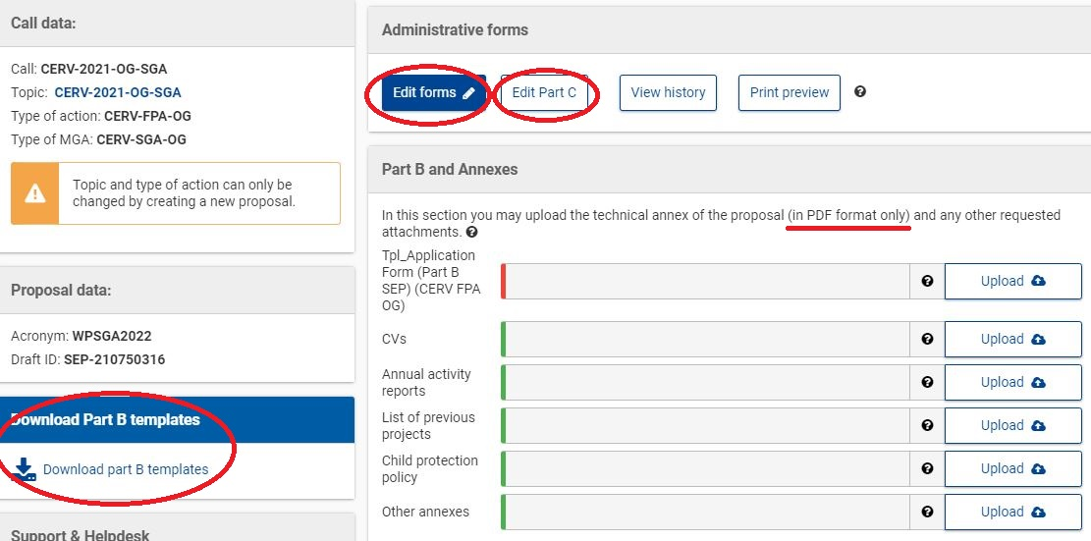
Application forms and annexes
Notes:
When you start applying at F&T opportunities portal, this is how it looks in practice

Slide 38
Evaluation
How we evaluate proposals
Evaluation crieteria
Admissibility
Eligibility
Exclusion
Selection
Award

Slide 39
Admissibility
Electronically: SEP Grant Application Form
Complete: Part A, part B, part C, annexes
Notes:
We also check the following:
The coordinator declares to have the explicit consent of all partners on their participation and on the content of this proposal. Or the single applicant confirms the content of this proposal.
The information contained in this proposal is correct and complete. None of the actions foreseen in the proposal have started prior to the date of submission of the current application.
The coordinator hereby declares that to be fully compliant with the exclusion and eligibility criteria set out in the call for proposals/topic, and to have the financial and operational capacity to carry out the proposed actions. (and the same for partners) [He also declares that each partner has confirmed that they are fully compliant with the exclusion and eligibility criteria set out in the call for proposal/topic, and they have the financial and operational capacity to carry out the proposed action. Or the single applicant declares that he is fully compliant with the exclusion and eligibility criteria set out in the call for proposal/topic, and has the financial and operational capacity to carry out the proposed actions.

Slide 40
Eligibility
Organisations: legal entity (public or private body)
Eligible countries: EU Member States
Project national or transnational
Applicant with partner(s)
Minimum requested amount > e.g. EUR 75 000
Project duration e.g. max 24 months
Notes:
Public/private entities or organisations, established in one of the countries participating in the programme, or international organisations. Organisations which are profit-oriented apply in partnership with public entities or private non-profit organisations.

Slide 41
Exclusion
Self-declaration in Part A
Applicants/partners cannot participate:
bankrupt, subject to insolvency or winding-up procedures…
in breach of their obligations relating to the payment of taxes or social security contributions…
guilty of grave professional misconduct…
fraud, corruption, links to criminal organisation, money-laundreing…
See Articles 136 and 141 of EU Financial Regulation 2018/1046.
Notes:
Professional misconduct includes: violation of ethical standards of the profession, wrongful conduct with impact on professional credibility, false declarations/misrepresentation of information, participation in a cartel or other agreement distorting competition, violation of IPR, attempting to influence decision-making processes or obtain confidential information from public authorities to gain advantage.

Slide 42
Selection criteria
Operational capacity
CVs of the key project staff members – Annex 1
Annual activity report of the applicant – Annex 2
Financial capacity (no checks for public bodies) → documents NOT to be provided at application stage, but if proposal is selected for funding
Balance sheet & loss and profit accounts – 2 years – Participant register
Audit report (grants > 750 000 €) – 2 years – Participant register
Due recovery orders, etc.
Notes:
Financial capacity
Applicants must have stable and sufficient resources to successfully implement the projects and contribute their share. Organisations participating in several projects must have sufficient capacity to implement all these projects.
[The financial capacity check will be carried out on the basis of the documents you will be requested to upload in the Participant Register during grant preparation (e.g. profit and loss account and balance sheet, business plan, audit report produced by an approved external auditor, certifying the accounts for the last closed financial year, etc). The analysis will be based on neutral financial indicators, but will also take into account other aspects, such as dependency on EU funding and deficit and revenue in previous years.
The check will normally be done for all beneficiaries, except:
public bodies (entities established as public body under national law, including local, regional or national authorities) or international organisations
if the individual requested grant amount is not more than EUR 60 000.
If needed, it may also be done for affiliated entities.
If we consider that your financial capacity is not satisfactory, we may require:
further information
an enhanced financial responsibility regime, i.e. joint and several responsibility for all beneficiaries or joint and several liability of affiliated entities (see below, section 10)  prefinancing paid in instalments
(one or more) prefinancing guarantees (see below, section 10)
Or
propose no prefinancing
request that you are replaced or, if needed, reject the entire proposal.
For more information, see Rules for Legal Entity Validation, LEAR Appointment and Financial Capacity Assessment.

Slide 43
Award Criteria
Award criteria | Minimum pass score | Maximum score
Relevance | 25 | 40
Quality | n/a | 40
Impact | n/a | 20
Overall (pass) scores | 70 | 100

Slide 44
Award criteria (100 points)
Relevance (40 / 100; threshold 25 / 40)
Priorities of the call for proposals
Needs assessment
Identification of target groups
EU added value: implementation of Union law, cross-border cooperation, transfer of good practices and transnational impact
Synergies and duplication with other Union programmes
! Gender equality and gender & non-discrimination mainstreaming !

Slide 45
Award criteria
Quality (40 / 100)
Methodology = Link between needs - objectives - activities - results; meaningful participation of target groups
Organisation of work between partners, time schedule
Risk identification, monitoring & evaluation
Ethics
Financial feasibility & cost-effectiveness
! Gender equality and gender & non-discrimination mainstreaming !
Notes:
Ethics: measures to be taken and the policies in place to guarantee full compliance with the EU values mentioned in Article 2
The financial feasibility of the proposed activities has to be demonstrated by means of a realistic and reasonable budget. The amount requested shall be appropriate in relation to the type and scale of envisaged activities. In addition, all the activities need to be appropriately reflected in the budget. Aspects to be looked at when analysing financial feasibility:
Management and coordinating activities and costs;
Distribution of funds between partners reflecting the allocation of activities and tasks among them;
Distribution of costs among cost categories;
Costs and human effort amounts per work package;
Justification of travel and subsistence costs in relation to the number of events, meetings, duration, number of participants planned;
Basis of other goods, works and services as function of the type of activities/deliverables planned;
Justification of subcontracting and corresponding amounts presented under cost heading B, subcontracting.
The budget should reflect the work packages (ex. dissemination activities should be reflected in the budget) and the expected outputs (ex. International Conference costs).
In case the budget presented in the application differs between the Part A (administrative form) and Part B (project description form) of the application, the evaluator shall inform the call coordinator.
The principle of cost-effectiveness concerns the relationship between the estimated costs / resources employed and the expected results to be achieved. In other words, the amount requested for implementing the activities and size of the partnership shall be appropriate in relation to the expected results. The ratio between the estimated costs and the expected results shall be satisfactory. Aspects to be covered when analysing cost-effectiveness:
Relationship between direct personnel costs and human effort in person-months, the tasks, the profiles of key persons (see Part B) and the countries where beneficiaries are based. i.e. one year of full time employment of one staff member = 12 person-months, so 24 full working days = 1.31 person-months). Applicants often miscalculate the human effort amounts, however this cannot be the only basis to justify low marks under this criterion.
Share of direct personnel costs and the share of other cost headings (subcontracting, purchase costs) compared with the results. Projects with proportionally high personnel costs should be looked at with particular attention.
Budget irregularities.

Slide 46
Award criteria
Impact (20 / 100)
Results/outcomes, immediate changes on the target groups
Dissemination strategy
Multiplier effect
Sustainability after end of EU funding, long-term impact, long-term socio-economic consequences
! Gender equality and gender & non-discrimination mainstreaming !

Slide 47
What makes a good projects
Relevant, in line with policy priorities
Addresses a real need in the field
Well established methodology
Strong partnership (established in advance)
Strong EU dimension, EU added value
Realistic and sustainable results
Notes:
The key essentials of a good projects are

Slide 48
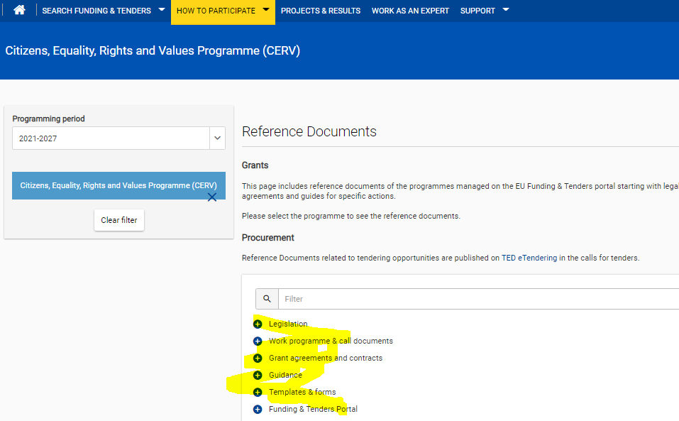
Reference documents
https://ec.europa.eu/info/funding-tenders/opportunities/portal/screen/how-to-participate/reference-documents
CERV Regulation
Work Programmes
Standard application form (in pdf)
Model grant agreement
Reporting templates

Slide 49
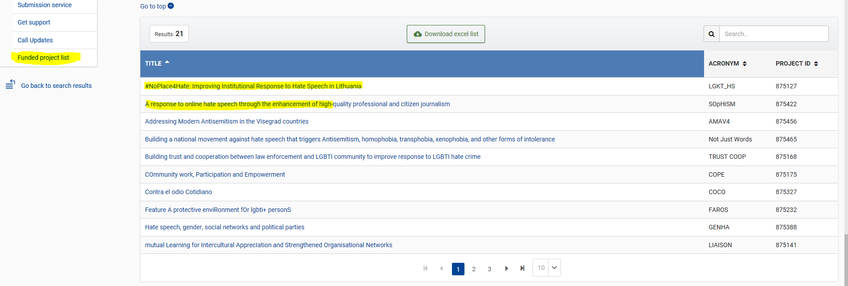
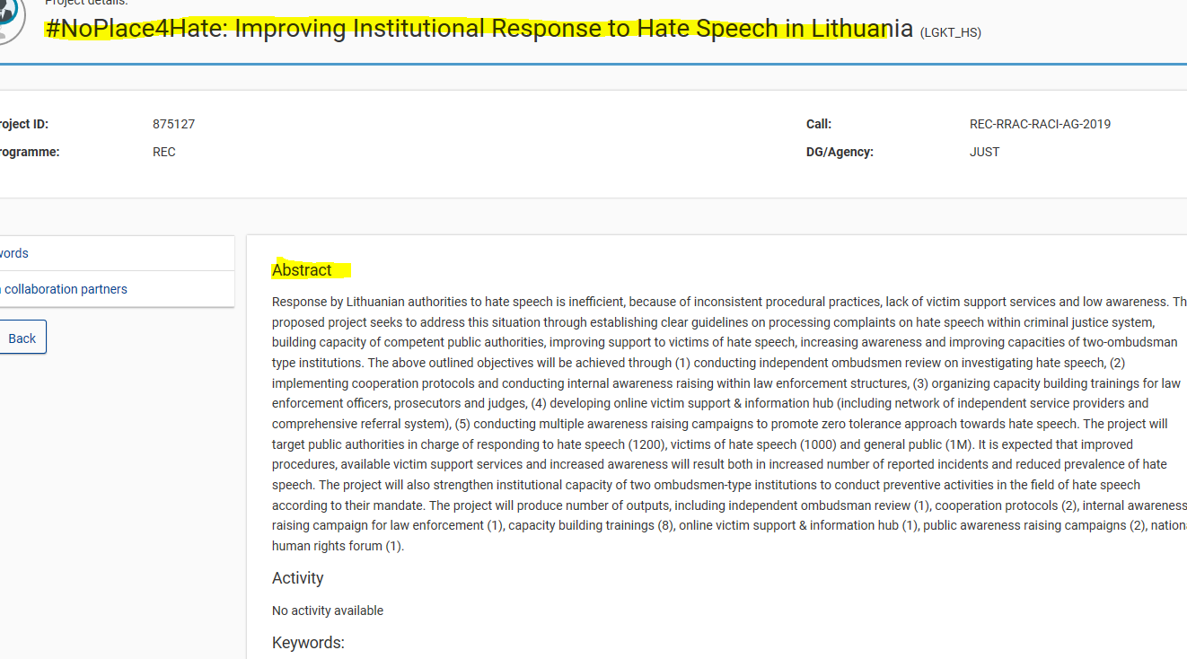
List of projects awarded
In each call for proposal webpage → at the bottom
e.g. Call for proposals to prevent and combat racism, xenophobia, homophobia and other forms of intolerance (REC-RRAC-RACI-AG-2020)
Notes:
Many of the current and upcoming calls are similar to the calls organised in the previous years

Slide 50
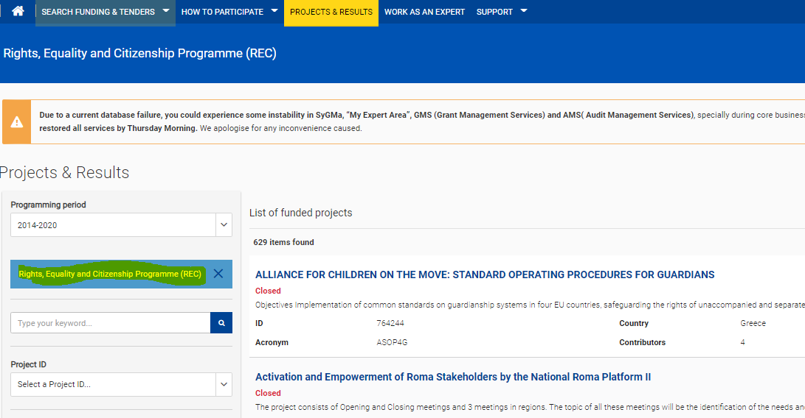
Projects & results
https://ec.europa.eu/info/funding-tenders/opportunities/portal/screen/opportunities/projects-results;programCode=REC

Slide 51
Contacts and useful links
See the CERV Programme structure, the Work Programme and Regulation
Subscribe to DG Justice Newsletter

Slide 52
Thank you
© European Union 2020
Unless otherwise noted the reuse of this presentation is authorised under the CC BY 4.0 license. For any use or reproduction of elements that are not owned by the EU, permission may need to be sought directly from the respective right holders.
European Commission Directorate General for Justice and Consumers

