Slide 1
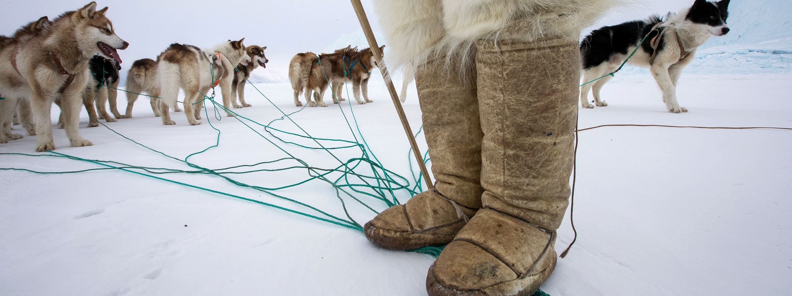
Welcome to Greenland

Slide 2
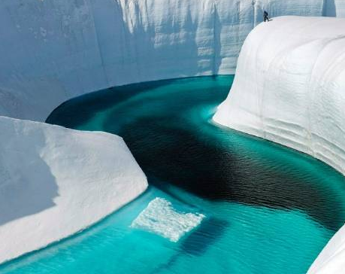
Agenda
Greenland in figures
300 years in two minutes
Our economy
Greenland and the EU
Q&A

Slide 3
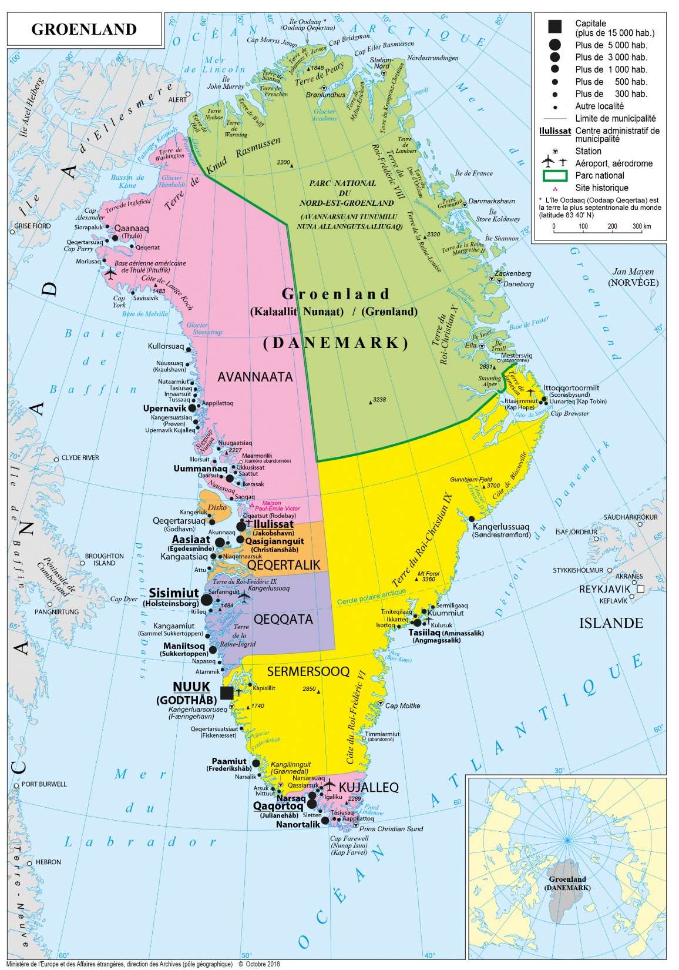
Greenland in figures
Size 2.166.086 km2
81 pct. covered by the ice sheet
Population 56.412 (more than 18.800 in the capital city Nuuk)
More than 6.000 are not born in Greenland
More than 16.000 people born in Greenland live in Denmark

Slide 4
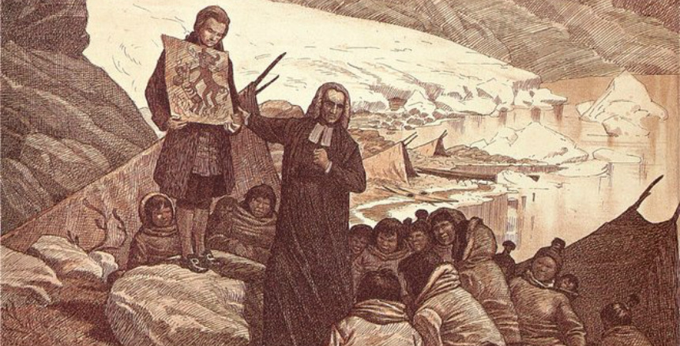

Slide 5
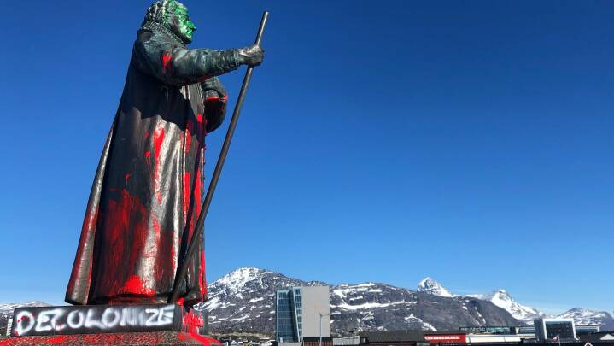
800 AC Last migration wave from North America, the Thule Culture
980-1400 Norse settlement (Vikings)
1721 Danish colonization Hans Egede
1953 Greenland shifts status from colony to a Danish county
1979 Greenland gets home rule
2009 Self-government is granted

Slide 6
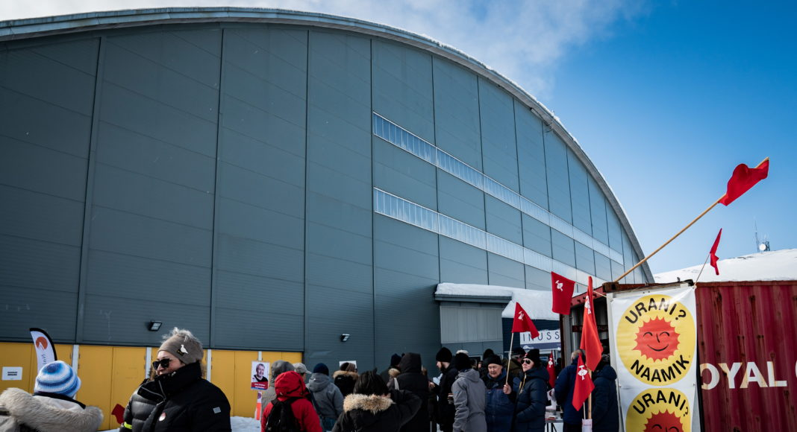
Greenland is a self-governing region within the Kingdom of Denmark. A few policy areas remains however to be determined by the Danish Government, including foreign policy, citizenship, monetary policy, justice and defense.

Slide 7
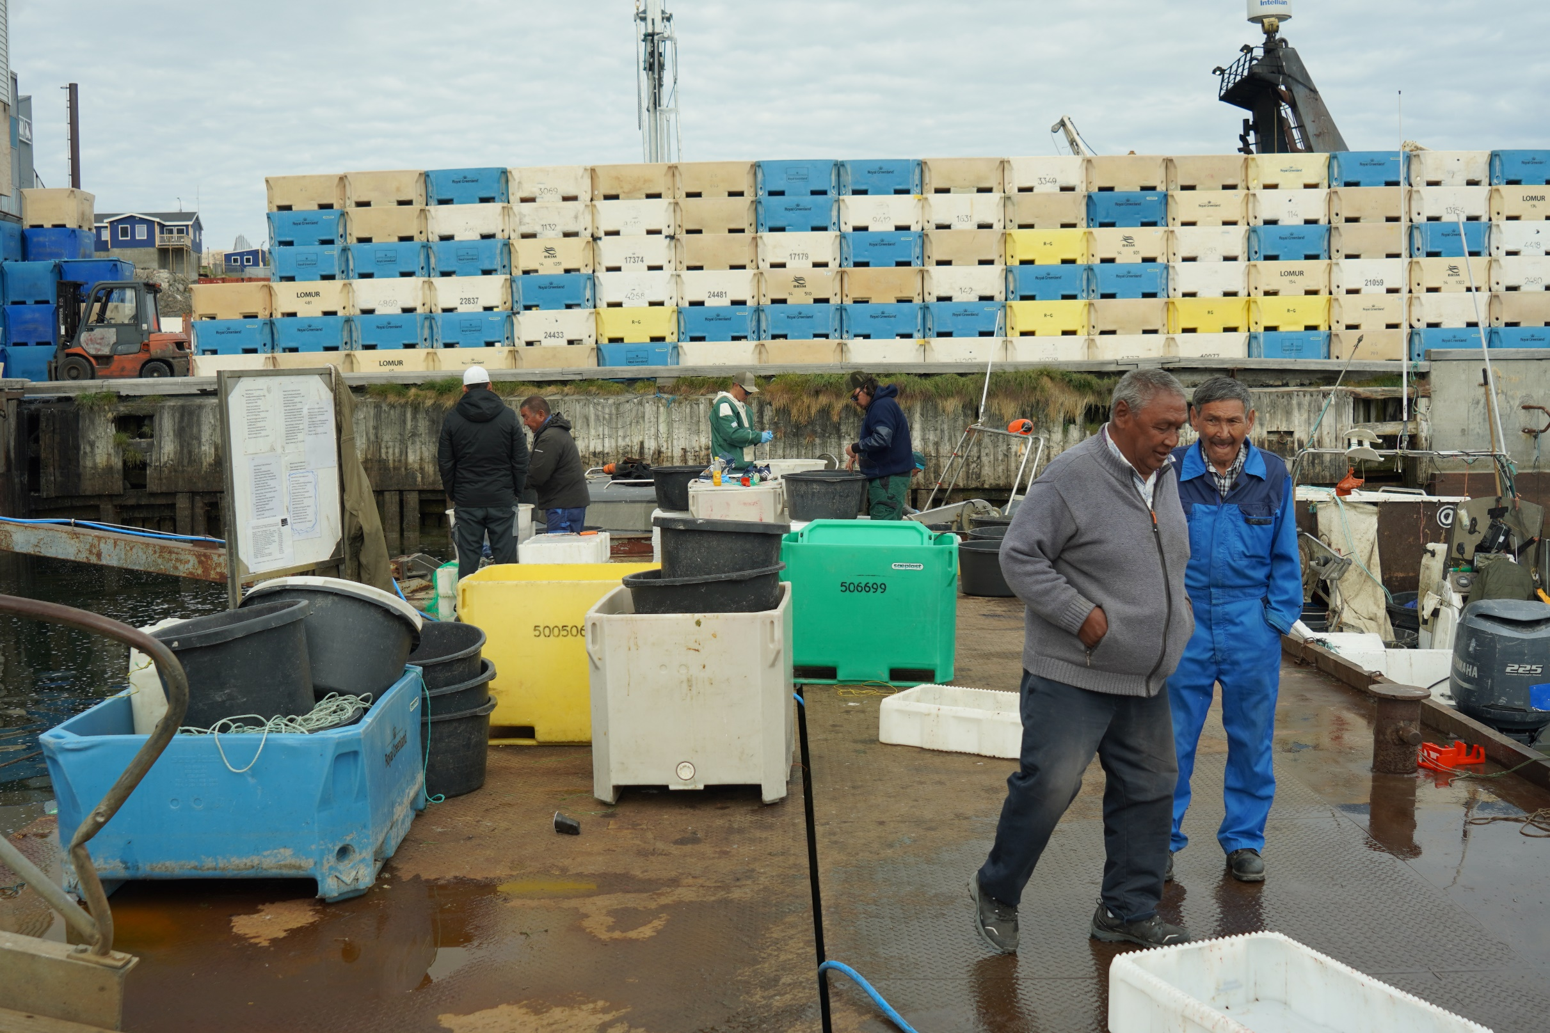

Slide 8
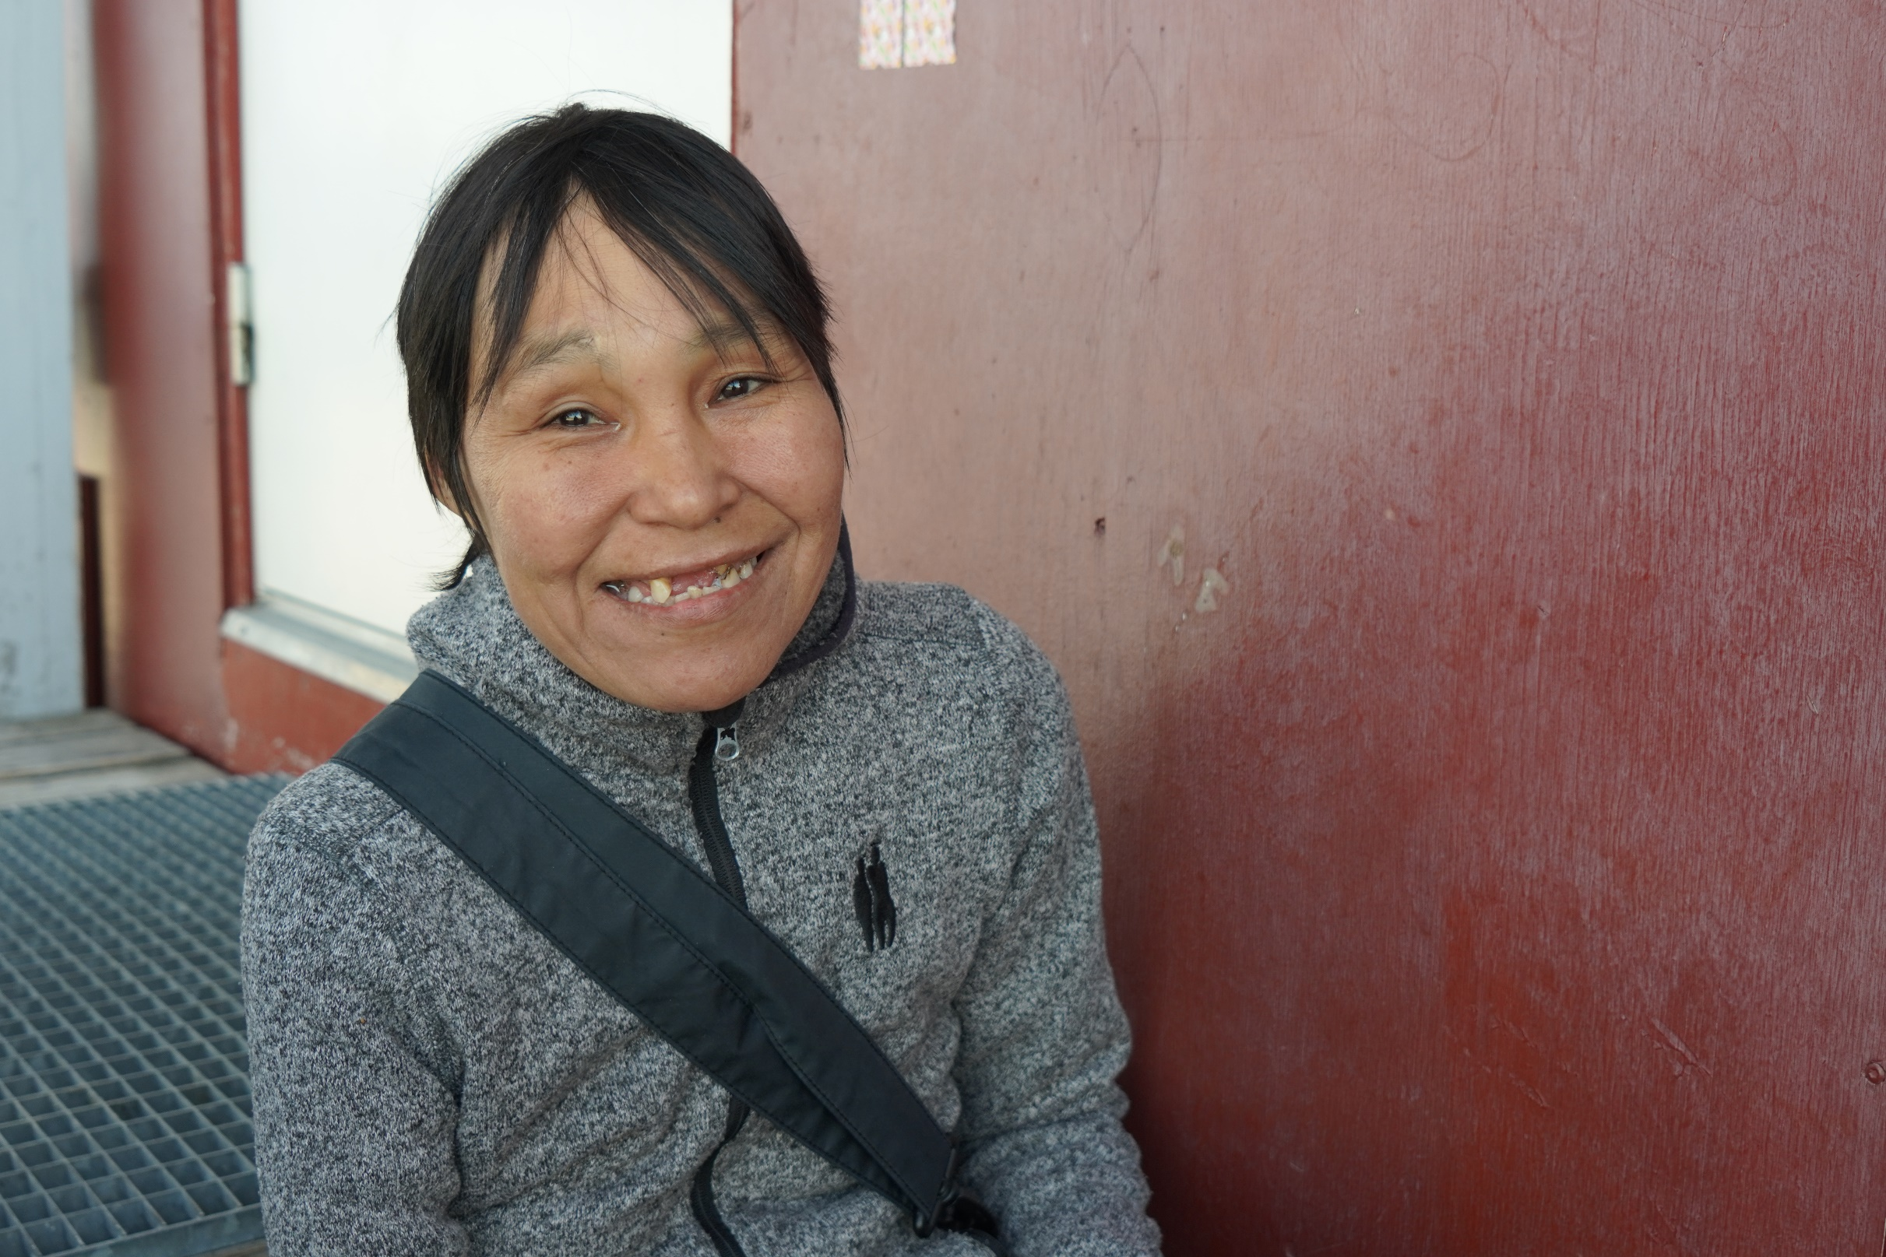
Supply and demand GDP | 2019
Current prices, million dkk
Gross Domestic Product | 19,889.8
Imports of goods and services | 10,163.0
Supply Total | 30,052.7
Private consumption | 7,172.5
Government consumption | 8,913.9
Gross investment | 6,252.6
Exports of goods and services | 7,713.8
Net export | -2,449.2

Slide 9
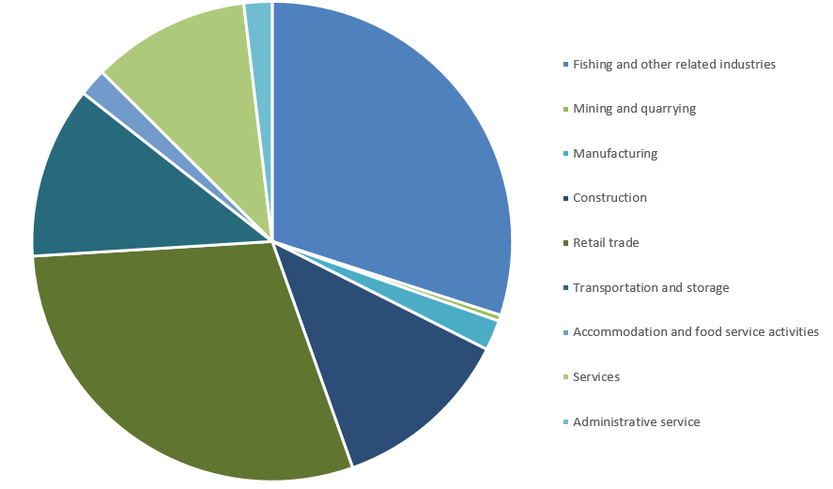
Production by industries
Year 2019. Source: bank.stat.gl

Slide 10
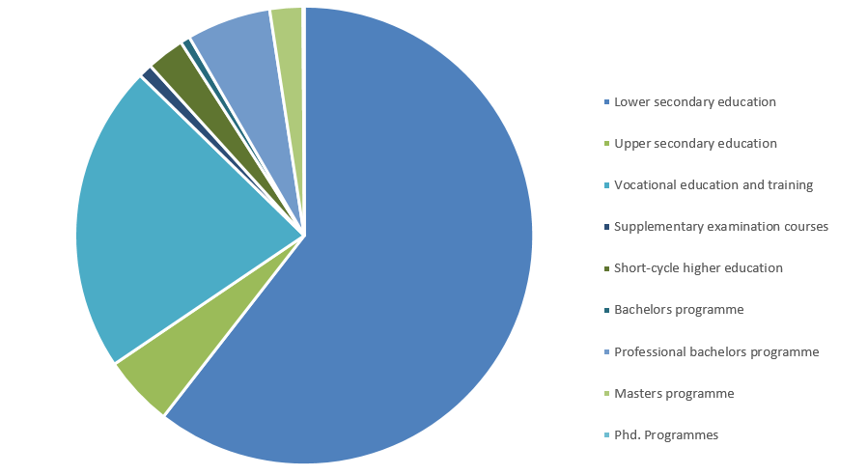
Educational attainment (16-74 years)
Year 2019. Source: bank.stat.gl

Slide 11
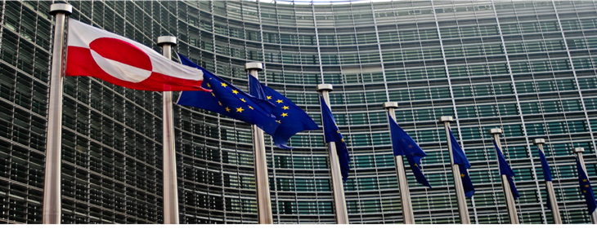
EU – Greenland relations

Slide 12
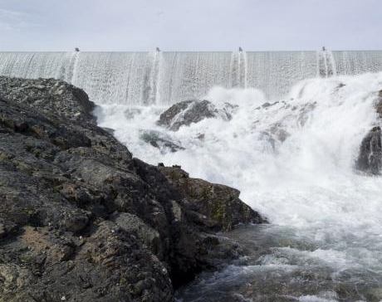
Hydropower and energy export can become a new important industry in Greenland

Slide 13
Thank you
Photo: Mads Phil, Visit Greenland

Slide 14
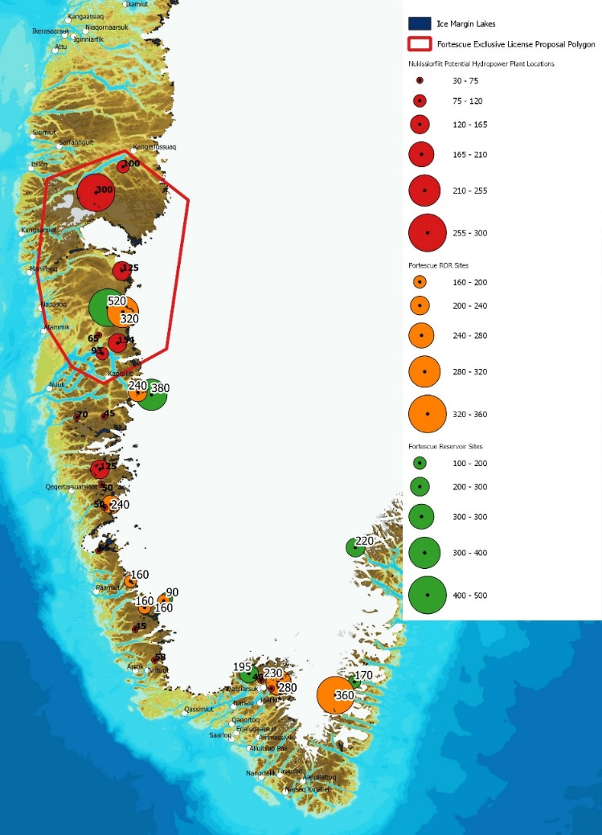
Hydropower in Greenland

Slide 15
Vandkraft holder Grønlands CO2-udledning nede

Slide 16
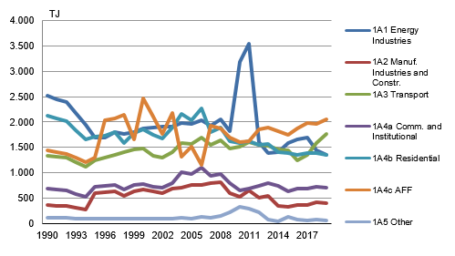
Fiskeriflåden og transport sektoren største udledere af CO2

