Slide 1
The InvestEU Programme
Presentation to OCTs
Filippo Munisteri
30 June 2021

Slide 2
1. InvestEU Key Principles

Slide 3
Main principles
Single programme: a single Regulation and agreement with implementing and advisory partners
Direct access to the EU guarantee open to multiple implementing partners
Policy driven approach: four thematic policy windows
Budgetary guarantee: no funded instruments
Member State compartment: synergies with structural funds and with RRF
Blending: harmonised combination rules

Slide 4
Main points of interest for OCTs
The OCT Investment Facility which existed under OCT Decisions has ceased to exist
OCTs eligible under InvestEU through a budgetary guarantee
EIB still the prime implementing partner with 75% of the guarantee allocated, but no geographical ring-fencing unlike the OCT IF
Access to financial instruments supported by the budgetary guarantee available on a competitive basis and in market driven manner
Technical assistance available, linked to project development.
Intermediated finance possible

Slide 5
InvestEU Fund
Single fund bringing together the many different EU-level financial instruments, provisioned at 40%
EUR 26.2 bn EU budgetary guarantee (EU compartment)
Mobilise EUR 370 bn in additional investment across Europe
Four thematic policy windows

Slide 6
Legal base for OCTs
Recital 69
(…) individuals and entities established in overseas countries or territories are eligible for funding subject to the rules and objectives of the InvestEU Programme and possible arrangements applicable to the Member State to which the relevant overseas country or territory is linked
OCTs assimilated to MSs in Article 14.2 and 14.3
Stand-alone operations are possible

Slide 7
2. Overview

Slide 8
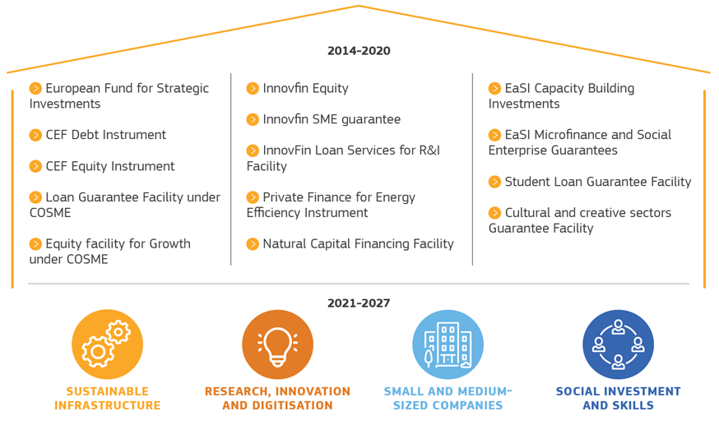
InvestEU Programme: an overview
InvestEU Fund:
Single fund bringing together the many different EU-level financial instruments
EUR 26 bn EU budgetary guarantee
Mobilise EUR 370 billion in additional investment across Europe, of which 30% to contribute to climate objectives
Strategic Investments incorporated under all other investment windows
STRATEGIC EUROPEAN INVESTMENT

Slide 9
General scheme
Implementing Partners (IPs)
Beneficiaries
Programmes
Direct loans
SI window
Financial intermediaries:
Banks, guarantee societies, microfinance providers, venture capital, equity funds, etc.
RID window
InvestEU Guarantee
MS compartment
SMEs window
Financing (loans, guarantees and venture capital/ equity investments)
SIS window
Other IPs (IFI, NPB)
SEI window

Slide 10
EU Guarantee: what will be covered
Principal + interest
Debt products
Restructuring losses
Losses from currency fluctuations
EU guarantee
Amounts invested
Equity and quasi equity products
Funding costs and currency losses
Transitional Provisions:
Warehousing to avoid financing gaps
Consolidation of portfolios (awaiting official mandate)
Funding/guarantees from implementing partners to other legal entities
Amounts used and funding costs

Slide 11
3. InvestEU: The Elements

Slide 12
Budgetary division between 4 windows under InvestEU
€ 9.9 bn in EU guarantee
€ 6.6 bn in EU guarantee
€ 6.9 bn in EU guarantee
€ 2.8 bn in EU guarantee
Link to Recovery and Resilience Facility: Funds from RRF may be contributed by MS for provisioning the InvestEU guarantee

Slide 13
Sustainable Infrastructure window
Policy objectives: Climate change and GHG emission reduction Cross-border infrastructure projects and trans-European networks Cross-sectoral synergies between energy, transport and digitalization Deployment of innovative technologies on the market 60% of the investment to contribute to EU objectives on climate and environment. |  | Final recipients targeted: Stand-alone promoters Corporate projects promoted by private, public and semi-public enterprises Special-purpose vehicles

Slide 14
Research, Innovation and Digitisation window
Policy objectives: Facilitate access to finance and de-risk investments in research & innovation and transfer results to the market Support digitisation to increase interoperability and address disparities Promote first-of-a-kind demonstration operations |  | Final recipients targeted: Stand-alone promoters, private and public companies Universities, technology transfer offices, higher education centres, research centres Research infrastructures Innovation and digitisation agencies, accelerators, incubators.

Slide 15
Small & Medium-sized Enterprises window
Policy objectives: Increase access to finance for SMEs and small mid-caps through debt and equity products Supporting businesses with problems of access to finance: start-ups, younger and smaller companies, businesses with a perceived higher risk and lacking (sufficient) collateral, and innovative ones. Promoting digitalisation, uptake of innovation, and cultural and creative industries |  | Final recipients targeted: Predominantly small and medium-sized enterprises (SMEs) Small mid-caps

Slide 16
Social Investment and Skills window
Policy objectives: Social resilience and inclusiveness of the Union through projects contributing to the objectives of the European Pillar of Social Rights Microfinance, social enterprise finance and the social impact and social economy Social infrastructure (incl. social services, social and student housing, education infrastructure, health infrastructure) Skills, education and training |  | Final recipients targeted: Micro-enterprises, social enterprises, vulnerable groups, self-employed, education and training providers, NGOs, health authorities, health service providers (public and private)

Slide 17
4. InvestEU Advisory Hub and Portal

Slide 18
InvestEU Advisory Hub implementation
Invest EU advisory hub
Central Point of Entry (European Commission)
EIB Group
Advisory Group
Financial intermediaries
Cross Sectoral Component
Cross-Sectoral
International Financial Institutions
Requests
Call for Proposals
Non-financial intermediaries
NPBIs
Policy Windows
Sustainable Infrastructure
Research, Innovation, Digitalisation & SMEs
Delivery mechanism
MS compartment
External Service Providers
Social Investment & skills
Call for tenders
Final beneficiaries (Public & Private)
Advisory Initiative

Slide 19
InvestEU Advisory Hub implementation
Provides advisory support for the identification, preparation, development, financial structuring, procuring and implementation of investment projects, or for enhancing the capacity of promoters and financial intermediaries to implement financing and investment operations
Integrates 12 advisory initiatives and the EIAH
Single point of entry managed and hosted by the Commission
Support to establish investment platforms
InvestEU
Advisory Hub
services:
Available under each
policy window
+
Cross-sectoral
advisory services
Assistance during the entire project life-cycle
Leveraging local knowledge
Support to capacity building for promoters and authorities
Promote sectorial and geographical diversification
Facilitate project development
Support to project origination
Facilitate aggregation of small projects
Market making activities
Notes:
Advisory services offered (under the advisory initiatives developed under the policy windows/cross sectoral component)
Project advisory
Project identification/generation including cross border investment
Project preparation and development, including for blending operations
Planning and implementation of investment projects
Financial structuring
Establishment of investment platforms and blending facilities
Capacity building
Strengthening capacity and investment readiness of organizations
Environmental and/or social sustainability structuring and impact assessments
Procurement and compatibility with State Aid rules
Market development
Market development activities
Communication and awareness raising

Slide 20
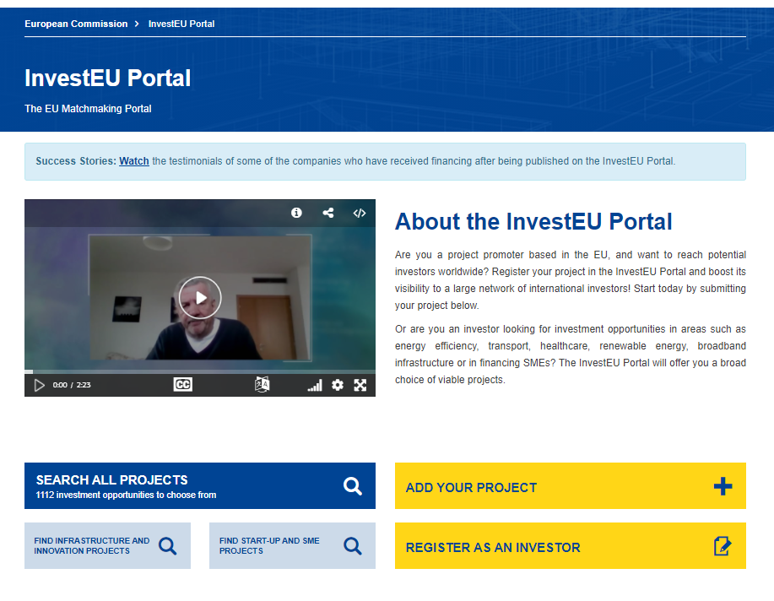
InvestEU Portal Bringing together promoters with investors
EU Promoters
International Investors

Slide 21
InvestEU Portal Promoters – Public or Private
To be eligible for publication, a project shall:
have a minimum size of EUR 500.000;
be situated in an EU Member State;
have started or be expected to start within three years of the date of submission;
be clearly described as an investment project;
be compatible with all applicable EU and national laws.

Slide 22
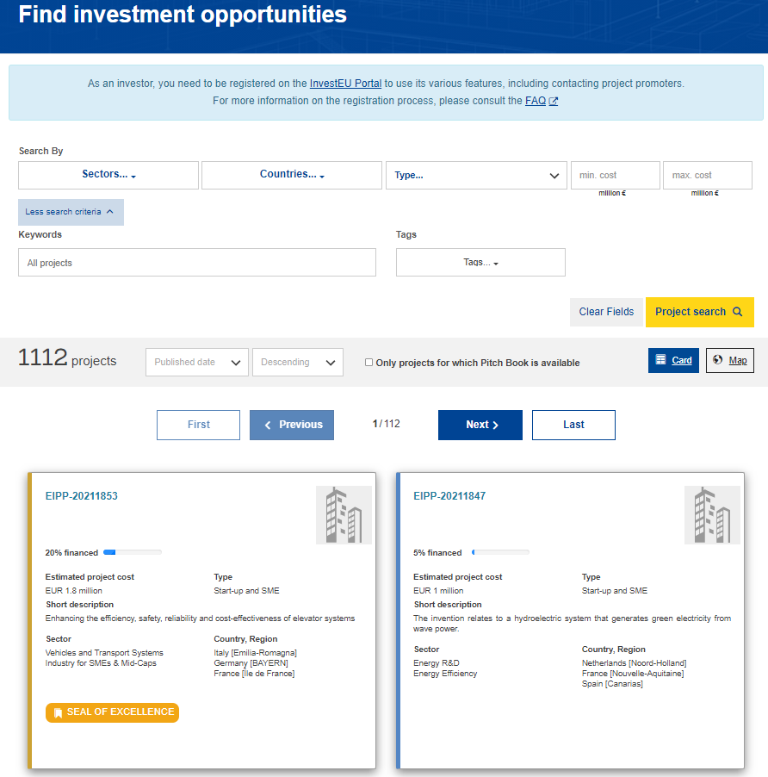
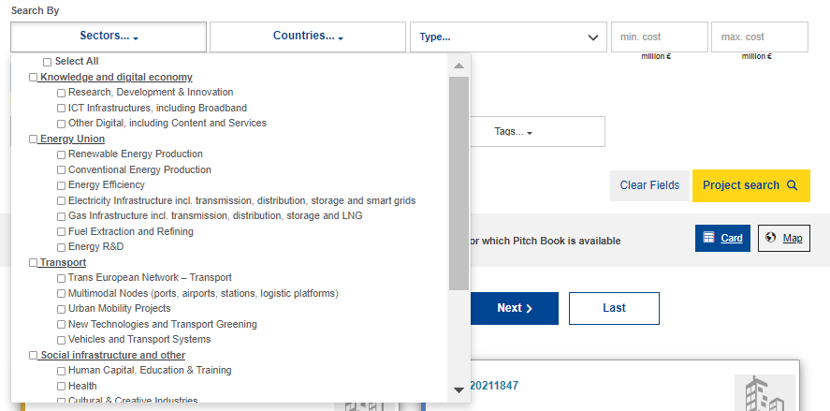
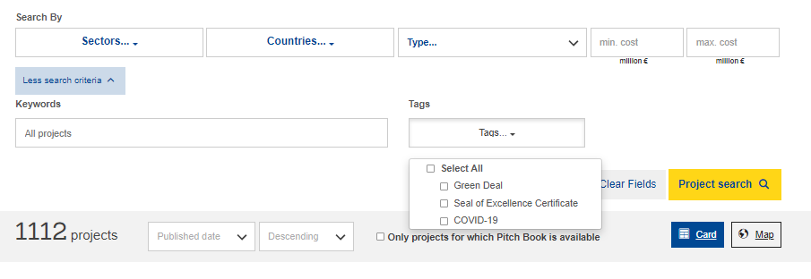
InvestEU Portal Promoters

Slide 23
Thank you
© European Union 2020
Unless otherwise noted the reuse of this presentation is authorised under the CC BY 4.0 license. For any use or reproduction of elements that are not owned by the EU, permission may need to be sought directly from the respective right holders.
Slide 1 to 54 : icon, source: flaticon.com (authors : inipagistudio / Freepik)
Notes:
Update/add/delete parts of the copy right notice where appropriate.
More information: https://myintracomm.ec.europa.eu/corp/intellectual-property/Documents/2019_Reuse-guidelines%28CC-BY%29.pdf

