Slide 1


Blue Economy Roadmap
Realising the potential of the overseas countries and territories for sustainable blue growth (blue economy)
Presentation COWI
(Ramon Wessel and Dr Karen Lupson)

Slide 2

Content
Introduction
Methodology
Findings
Recommendations

Slide 3

Introduction

Slide 4

Assignment
To develop and support
a distinctive OCT Blue Economy Sector (BES) for OCTs and provide robust guidelines to assist individual OCTs to fulfil their aspirations of identifying, and ordering their Blue Economy Industries into a sustainable and economically viable sector.
The OCTA Blue Economy Roadmap's vision is:
The OCTA Blue Economy Roadmap defines the Blue Economy to include all industrial/commercial sector activities that are marine-based or dependant on the marine environment.
ESTABLISHED SECTORS
EMERGING SECTORS
INNOVATIVE SECTORS

Slide 5

Project team
Dr Karen Lupson
Corinne Dubois
Michael Allen
Ramon Wessel
Team leader and Expert Maritime and Blue Tourism
Expert Blue energy
Expert food security
Project Director

Slide 6
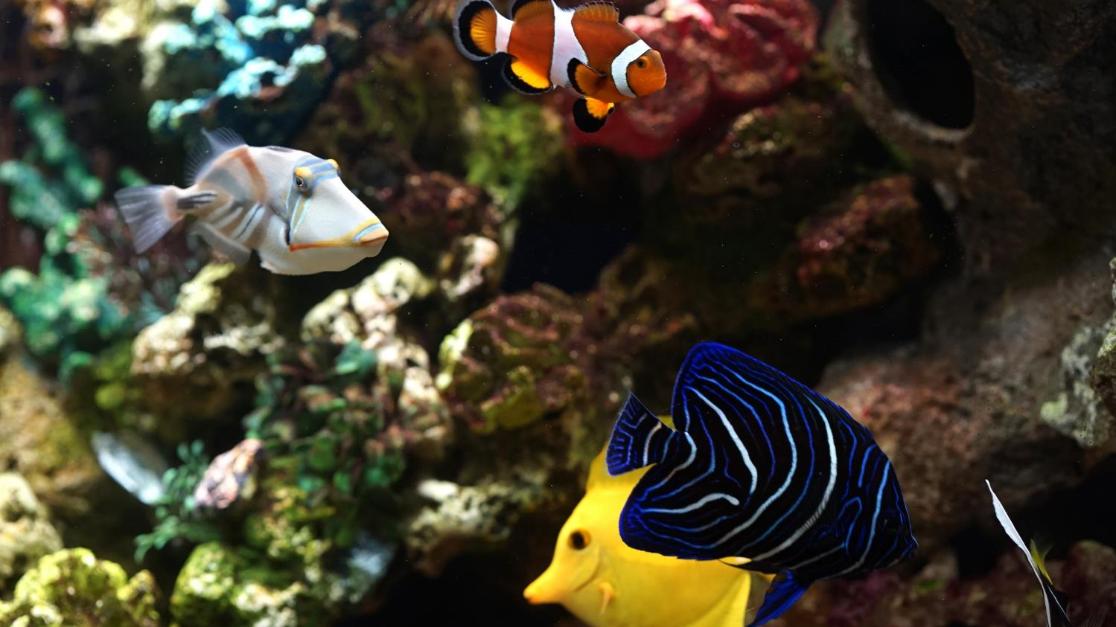
Methodology

Slide 7
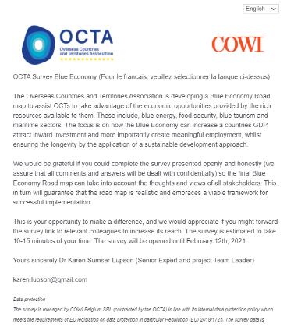
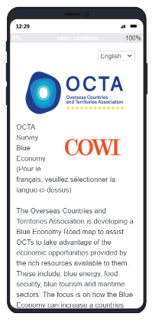
Methodology
Document review
  Reports, Policy, Strategy, Numerical
  Data Sheets, and Geo-Information for
  the OCTs identified
  Data library / Excel overview > mapping
  of area, sector, etc.
Survey (EN and FR)
  Custom designed online Survey
  69 completed surveys covering 132 representatives from OCT perspective
Interviews Interviews(online/telephone)
Sector | Number of respondents
Government or Government Agency | 41
Private Sector | 23
Academic/Research Institution | 5

Slide 8
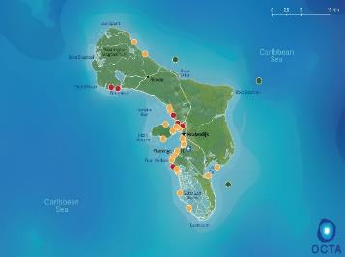
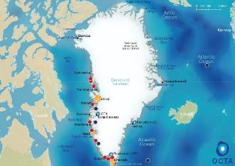
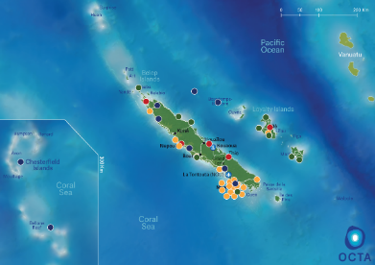
Mapping of potential locations
Maps showing locations related to food security, blue energy, blue tourism, and maritime. A more detailed and interactive map is available through the links in the report.
All marked locations are described below the maps in the report.

Slide 9
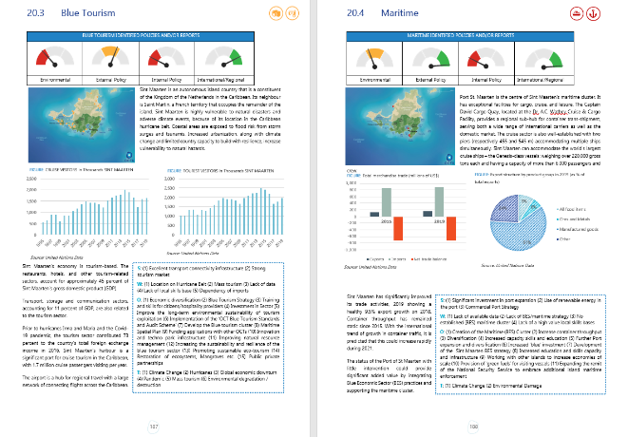
OCT profiles
The OCT profiles each consist of 5 pages which contain a general introduction, and a page for each of the topics: food security, blue energy, blue tourism, and maritime.
Dials on the top of the page to indicate the status of identified policies and/or reports in the OCT on a specific topic.
Each topic also contains a SWOT analysis, which emphasizes the Strengths, Weaknesses, Opportunities and Threats.

Slide 10

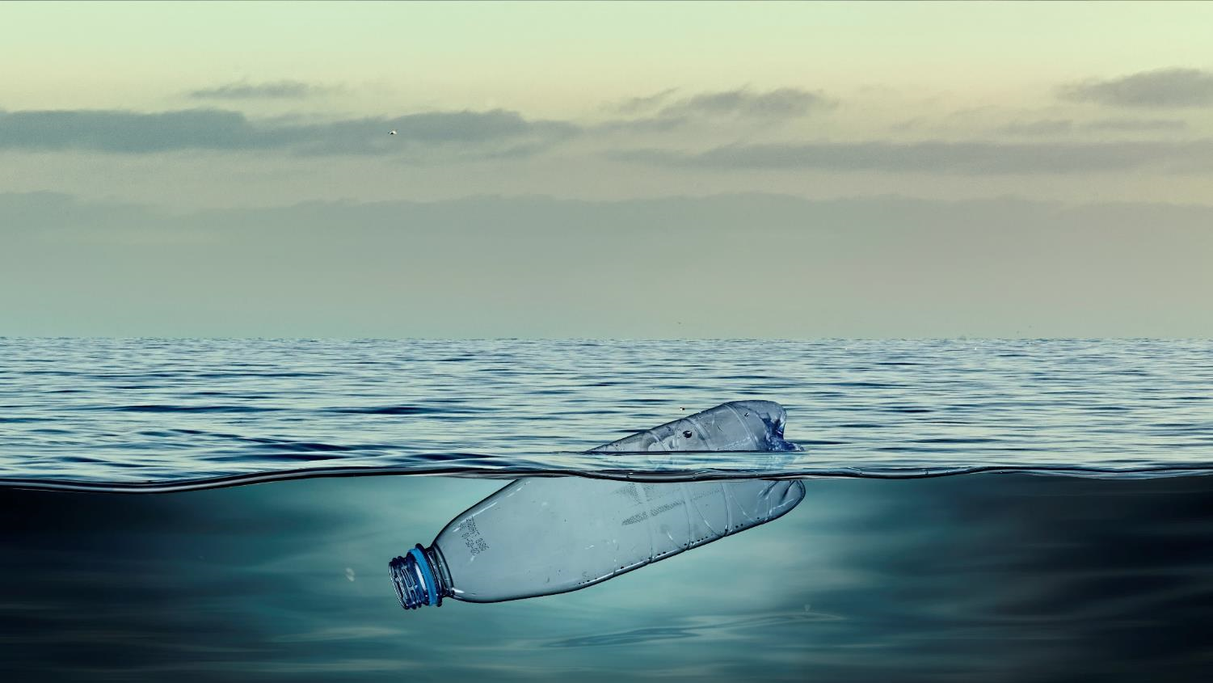
Findings

Slide 11

Strategic priorities
The very first and most important strategic priority was to ensure that the design composition embraced and then are developed from the priorities and needs of the OCTs.
OCTs express a unique position when considering the Blue Economy; this is very different to the position of the European mainland and for this reason it was vital that the roadmap should reflect the needs of OCTs and not simply reflect the priorities of Europe or other ‘continent’ roadmaps.
The development
of OCTA Blue Economy Roadmap set out to drive the core elements that would accelerate OCTs attainment of
a sustainable blue economy from the outset.

Slide 12


OCTs are Unique and thus must develop a Unique Approach!
The landscape of OCTs and SIDS’ vulnerabilities is constantly changing along with the world’s development dynamics. In the recent special report by the IPCC, the vulnerabilities of SIDS were projected to be significantly exacerbated by a 1.5 C warmer climate - threatening SIDS population’s health, livelihoods, food security, water supply, infrastructure, human security, cultural heritages and economic growth.
The anticipated decline of marine fisheries of
3 million metric tons per degree warming would have serious impacts for the Indo-Pacific region and the Arctic. Yet, simultaneously, various development opportunities are in play to help mitigate vulnerabilities and dependencies.

Slide 13

Strategic Priorites
STRATEGIC PRIORITY
STRATEGIC PRIORITY
1
2
To create and develop the OCT Blue Economy Sector (BES) to provide clarity for governments, private sector, academic sector, and investors.
Securing a Sustainable Resilient Knowledge Centric Framework for the OCT Blue Economy Sector (BES).

Slide 14

Strategic Priorites
Is based on sustainable fisheries
THE BLUE ECONOMY
Harnesses renewable energy
Is inclusive and improves lives of all
Uses smart shipping to lessen the impacts of the environment
Takes action against illegal fishing
Creates jobs, reduces poverty and ends hunger
Conserves marine life
and oceans
Protects coastal communities from the impacts of climate change
STRATEGIC PRIORITY
STRATEGIC PRIORITY
3
4
Reinforcement of the ocean environment, social and economic interface.
Safeguarding healthy, resilient,
and fruitful oceans, implemented through the creation of sustainable wealth and prosperous communities.

Slide 15
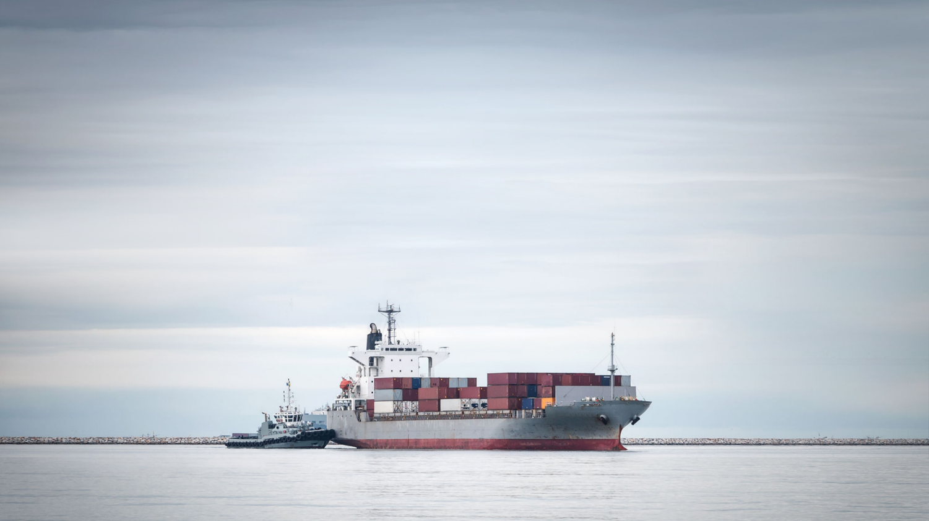
Recommendations

Slide 16

Blue Growth Observatories
Initiation of OCT Blue Growth Observatories to provide an investment platform creating cooperation prospects between BES sub-sectors and potential investor opportunities.

Slide 17
The design and implementation of an OCT Blue Investment Opportunity Study, which will identify and analyse all global BES investment opportunities, ‘current and projected’ and tailor those pertinent to OCTs BES activities.
Outputs to inform and guide the investment protocol for the OCT Blue Growth Observatories, for the benefits of all OCTs.
The OCT wide Investment Know-how Platform accessible by all OCTs.
This should use a virtual platform approach that OCTs can access in relation to the key sectors and provide a step by step approach to access BES investment where it exists.

Slide 18

Blue Economy Sector Expansion Study
The development of an OCT Blue Economy Sector Expansion Study
Identifying and clarifying the key contributing OCTs government departments and private industries.
The linkages between them.
A methodology for enabling BES critical mass.
A template for initiating focused and targeted communication and promotion of the BES.

Slide 19

Blue Economy Clusters
Dynamic
Clusters
In collaboration with established OCTs Maritime Clusters and with the National Maritime Cluster to develop a standardised OCTA template of all industries that contribute or facilitate to the Blue Economy Sectors.
Development of an OCT common platform tool (or offer an existing tool) to provide to every OCT an online template to enable OCTs governments an accessible means to develop national cluster development.
Strong
Economic
Infra-
structure

Slide 20
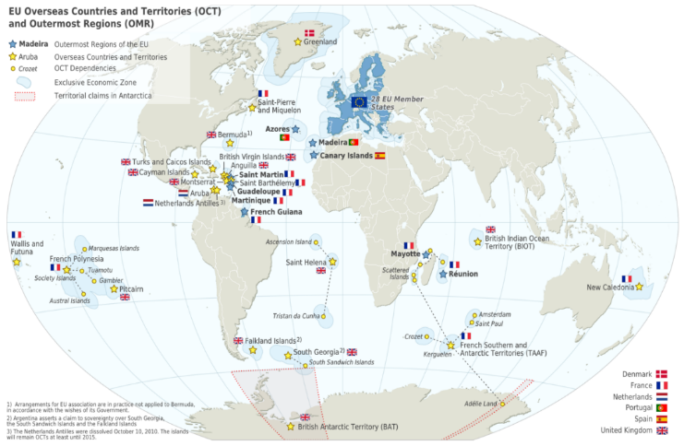
Develop the OCTA Blue Economy Sector Strategy aimed at providing an overall BES strategy for OCTs and a template that OCTs can utilise in the development of OCT National Blue Economic Sector Strategies.
Develop OCT horizon scanning capability that will match emerging new sustainable BES activities and identify those that can attract investment and generate employment opportunities for OCTs.

Slide 21
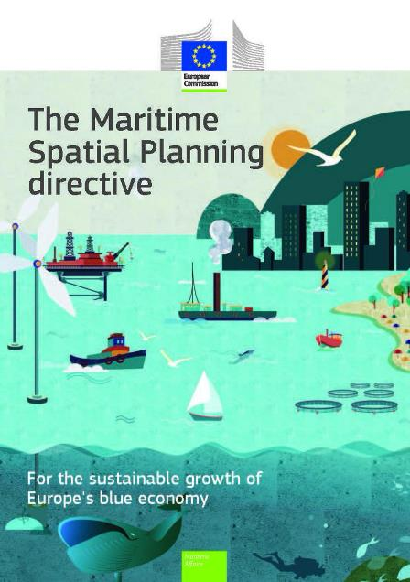
Maritime/Marine Spatial Planning
OCT requirement to establish targeted research capacity for environmental and marine spatial planning.
OCT requirement to establish targeted research capacity for maritime spatial planning.
Creation of OCT Maritime Spatial Plans.
Increase the remit of the PWP 3 platform (i) to identify, define and adopt strategic indicators and (ii) encourage the sharing of scientific carbon capture and ocean environment data by professional bodies in order to provide an alert system to help guide OCT decision making processes.

Slide 22

Knowledge Centric Approach – our next generation
OCTA Study, Developing OCT Blue Economy Human Capital Training and Education, a Guidance and Roadmap
Optimisation of Blue Economy Innovation and Incubation Centres and Technology Parks, Guide for OCTs to maximise investment programs to facilitate for sustainable growth

Slide 23
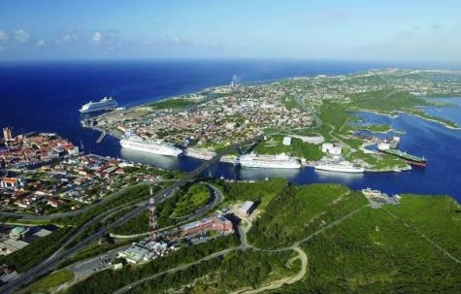

Tourism
Drafting the OCTA Blue Tourism Strategy inclusive of Guidelines on how to prevent impacts on biodiversity and enhance benefits for recreation and tourism through marine protected areas.
Develop the ‘OCT Blue Tourism Standards and Audit Scheme’, which will promote OCT sustainable tourism initiatives.
Develop an indicator system for the sustainable management at destination level and develop coastal and maritime tourism dedicated indicators; linked to the OCT Blue Tourism Standards and Audit Scheme.

Slide 24

Blue Energy
Drafting of an OCT Blue Energy Strategy that will take into account the sub recommendations.
Assist cooperation agreements with to develop a pilot project for Offshore wind energy and/or Wave and /or OTEC, with marine storage and marine green hydrogen production.
OCTs would benefit from pooling resources in an area that requires relatively high initial investments.
In the context of the further development of the BES clusters, the undertaking of a mapping of the key National stakeholders of the BES blue energy cluster subsector.

Slide 25
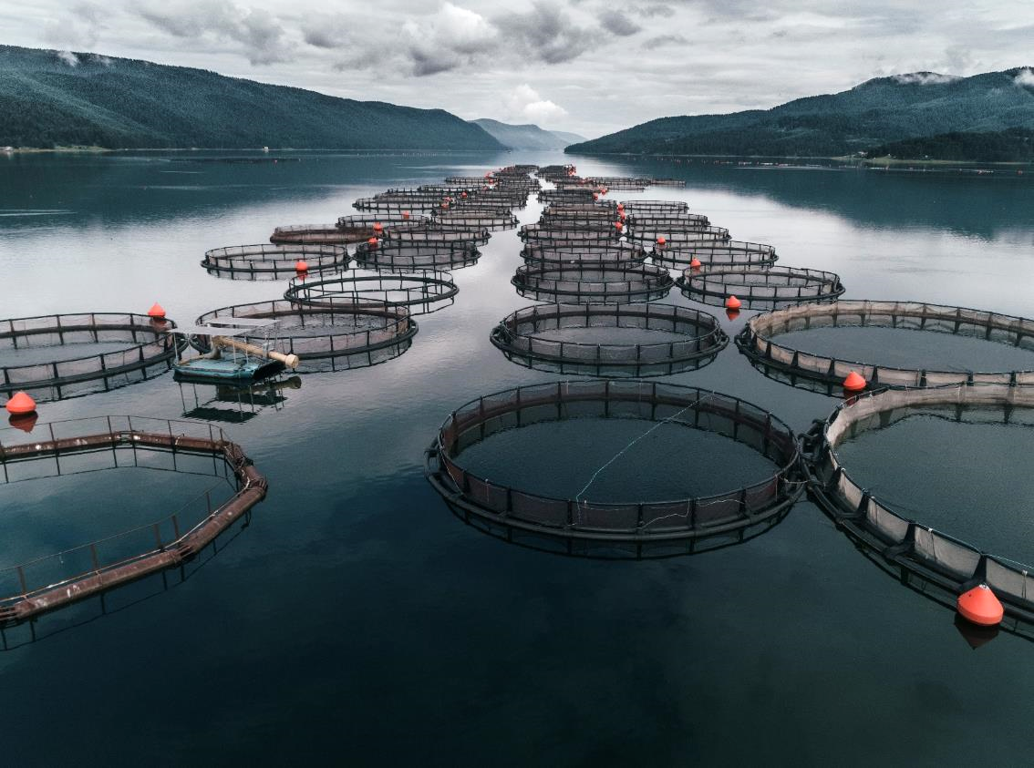
Blue Food Security
Development of OCT sustainable fisheries policies
OCTA study: Opportunities for BES fish processing plants, investment and global marketplace
OCTA Report: an economic study to provide guidance to the initiation and development of aquaculture sub-sectors for OCTs, aimed at exploiting sustainable resources, employment and increasing national GDP
Conduct a comprehensive resource inventory, as basis for guiding future policy on ocean exploitation
Increased government support to protect and increase areas of coral and mangrove

Slide 26
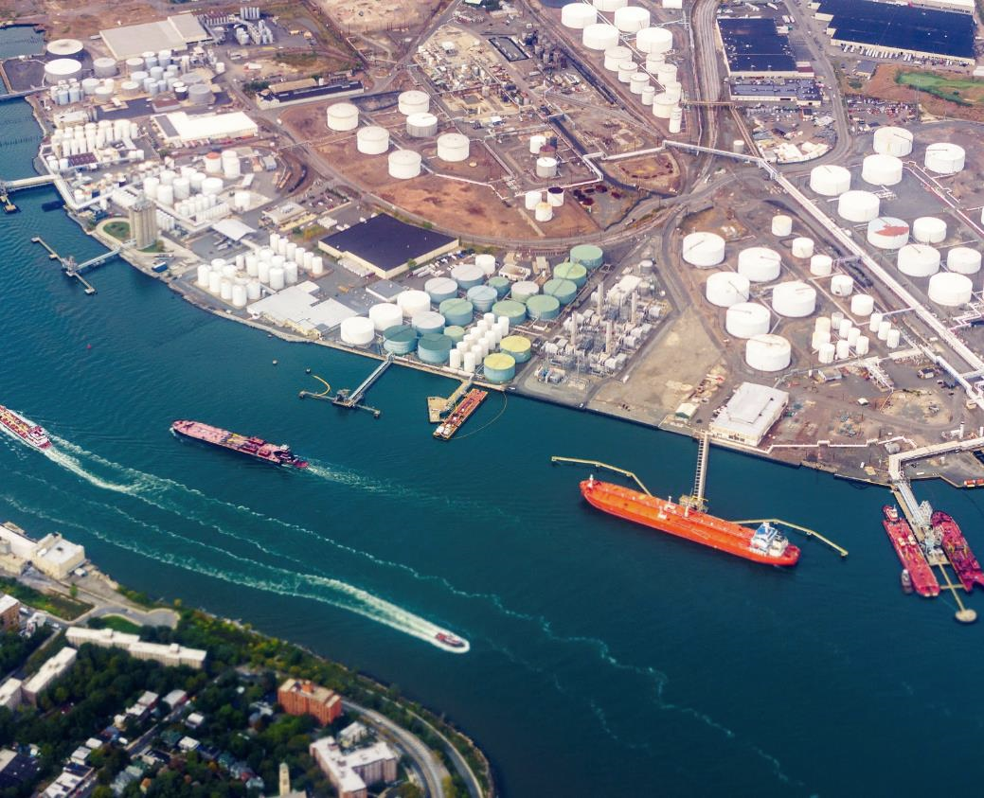
Blue Maritime
OCTA Study Outlining the Importance of Effective Maritime Governance and the Development of the BES for OCTs.
OCTA Study: Requirement of OCT BES Enforcement Protocols to reinforce the sustainable development of BES operations, and discourage unlawful practices.
Port infrastructure development to embrace ‘Green Fuels’.
Feasibility study, capacity of OCT ports to facilitate for focused BES development, to ascertain the potentials for placing specific BES infrastructure near or with access to the ocean within the confines or close to the port.

Slide 27

Questions

Slide 28
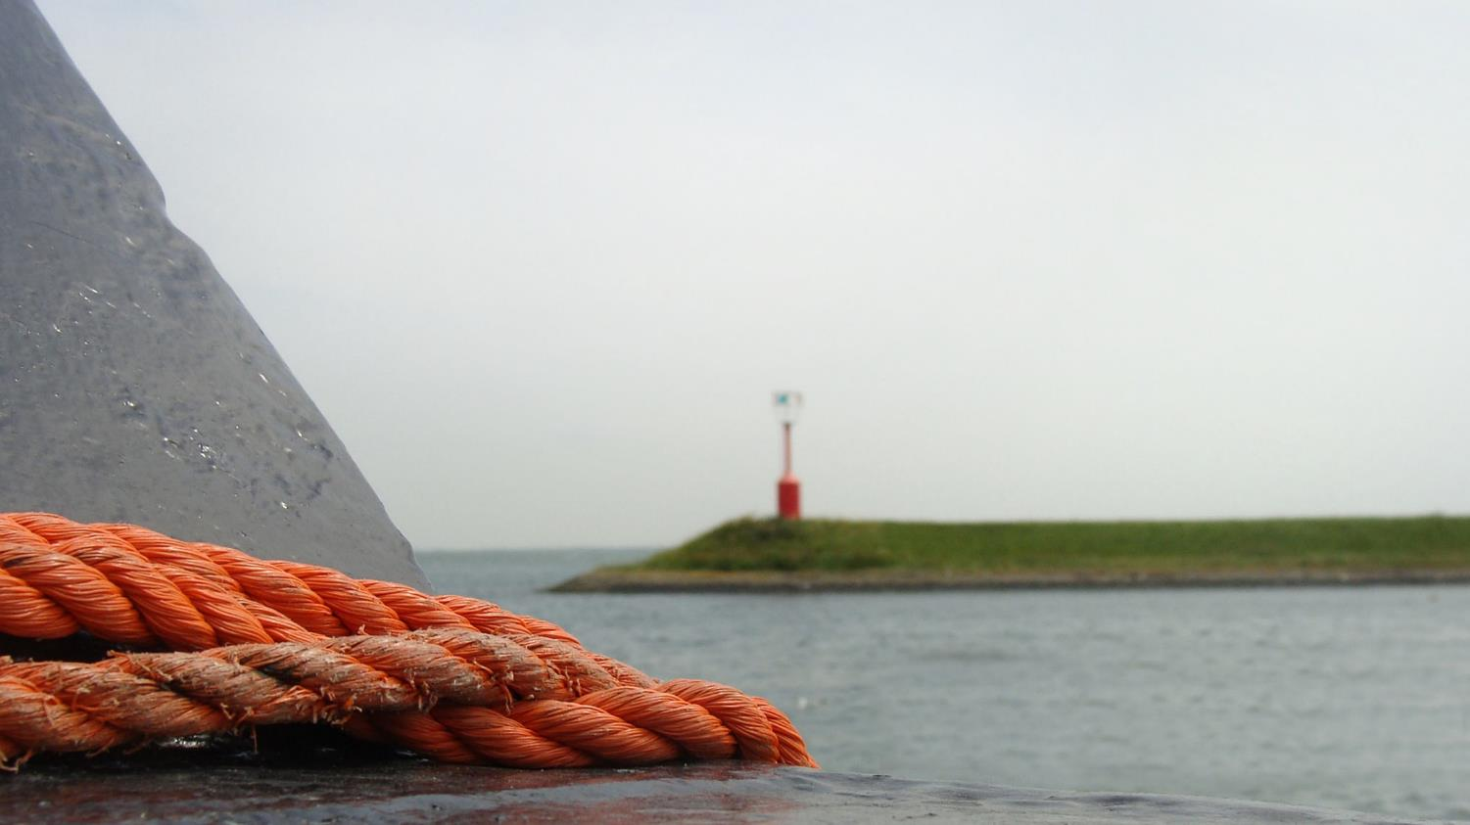
THANK YOU!

