Slide 1
Marie Skłodowska-Curie Actions (MSCA) Danish NCPs
Anne Maibohm amma@ufm.dk Marlis Erichsen mer@ufm.dk

Slide 2
EuroCenter at the Agency for Higher Education and Science
National Contact Point (NCP) for Horizon Europe – counselling and information about opportunities, requirements, rules for funding and project management.
Representing DK in programme committees under Horizon Europe and dialogue with Commission and Member States about structure and content of work programmes.

Slide 3
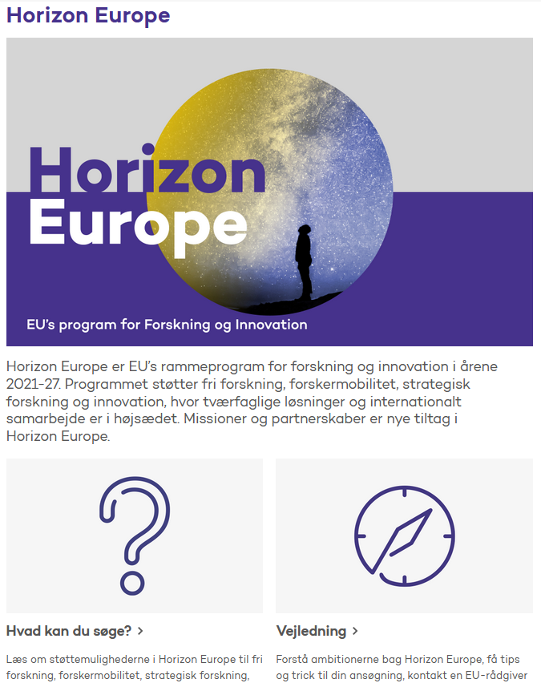
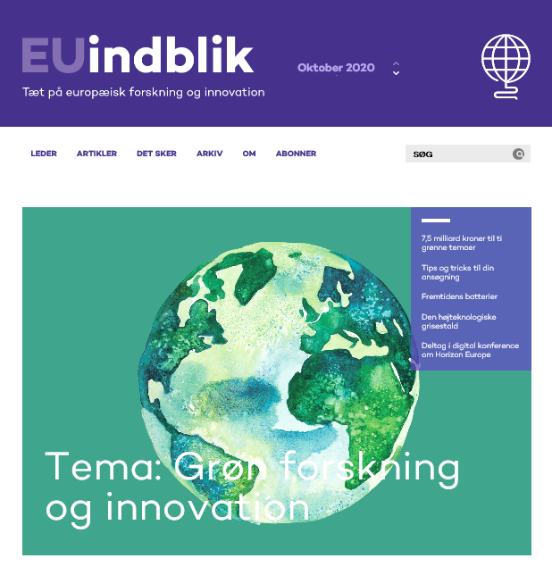
EuroCenter – Activities
www.ufm.dk/horizon-eu
www.euindblik.ufm.dk
Webinars, information meetings, podcasts, handbooks etc.

Slide 4
Advising on MSCA
Webinars
Q&A-session
News to networks - EU-DK support, EU erfa and MSCA erfa
Presentations at university kick-off meetings and info-meetings
Personal meetings
Replies to questions - by e-mail and phone

