Slide 1

The Enterprise Europe Network (EEN)
https://een.ec.europa.eu/
The world’s largest support Network for SMEs with ambitions to internationalise and innovate

Slide 2

Regionally based and connected to the EU and several third countries
3000+
600+
66
LOCAL
EXPERTS
COUNTRIES IN THE WORLD
LOCATIONS

Slide 3
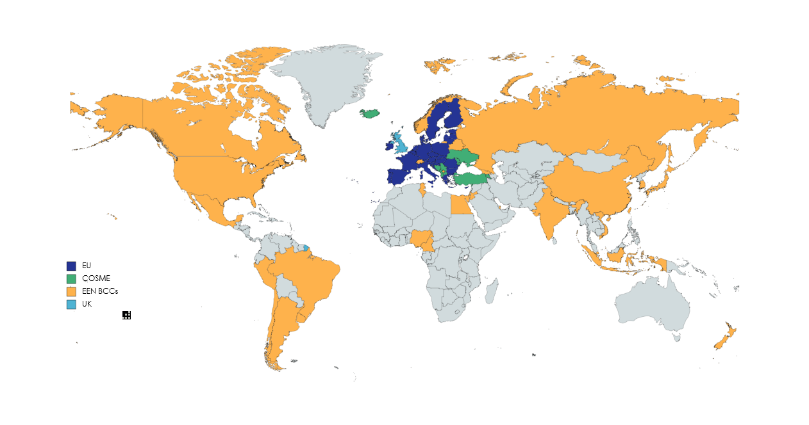
The EEN in Europe and the world

Slide 4
The Enterprise Europe Network (EEN)
Launched in 2008 (with roots back to 1987) the EEN is the main instrument of the EC to help SMEs do business, innovate and grow on an international scale (EU and beyond)
The EEN is made up of intermediaries organised within regionally based consortia
EEN consortia are contractually bound to deliver predefined sets of support services with an impact for SMEs (turnover, jobs, growth...)
EEN partners may have different specialisations (e.g. innovation, internationalization, access to finance…) but consortia deliver the whole set of EEN support services: “no wrong door principle”

Slide 5
EEN Host Organisations (HOs) are typically
Chambers of commerce
Research and innovation agencies
Regional and local entities
Industrial associations
Universities
Craft associations

Slide 6






















Examples: EEN Host Organisations (HOs)

Slide 7
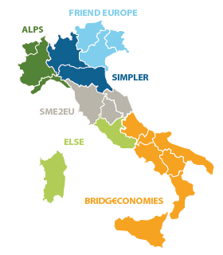
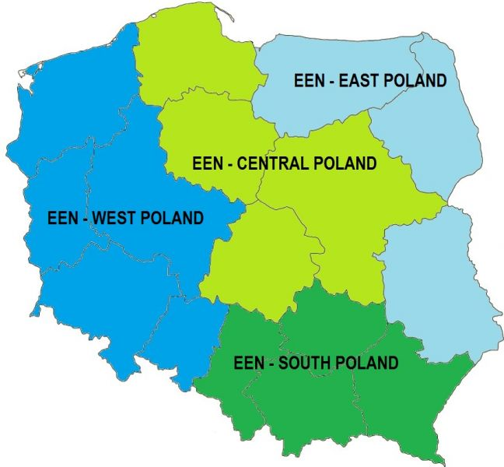
Example: how Network consortia are typically organised on the territory

Slide 8
How the EEN helps
Organised regionally the EEN combines knowledge of the local reality with international
expertise
All EEN support services for EU SMEs are free of charge for EU and COSME/SMP based SMEs
EEN HOs in the EU and COSME: EU grants up to 60% eligible costs. No grants for 3rd country HOs
EEN support is are organised in 3 main groups of basic and advanced support services:
1. Information, answers to SMEs…
2. Advisory Services
3. Matchmaking

Slide 9
Advisory Services
Access to finance & funding: support to identify sources of financial support at EU, national, regional and local level for SMEs to internationalise and innovate on an international scale
SME feedback: the EEN is a key communication channel connecting SMEs to the European Commission on selected EU legislation, policies, actions relevant for them
Innovation: eases SME access to European, national, regional innovation support schemes Delivers innovation management capacity building assistance to help SMEs in their innovation processes with focus on sustainability, digitalisation, and other advanced technologies
R&D funding advisory services in close cooperation with Horizon Europe National Contact Points

Slide 10
Advisory Services
EU legislation, standards, policies and programs: Advice to SMEs on compliance with EU laws, standards, policies relevant for them
IPR: first line assistance (EEN) + 4 IPR Help Desks: EU, China, Latin America, South East Asia
Scale up support: Scale-up Advisors to provide tailored advice to help start-ups and companies to scale-up, grow and innovate internationally
Sustainability: to help SMEs on more sustainable business models, the circular economy, resource efficiency… via Sustainability Advisors in all consortia
Digitalisation: to help SMEs use digital technologies, adapt processes, develop new products and services using digital means and so increase innovation and competitiveness. Future tight collaboration EEN-EDIH at regional and MS level. EEN to help SMEs use EDIHs

Slide 11
Matchmaking – Partnering
Business cooperation: Transnational transfer of goods and services (SME country A with SME country B)
Transnational transfer of technologies & knowledge: (SME country A with SME country B)
Exploitation of research results: mainly from public programmes (in particular EU) or through collaboration agreements with relevant European or international bodies
SME partnerships for EU RTD projects: support for the setting up of consortia for the participation to EU RTD programmes and projects

Slide 12
EEN methods/tools to match transnational demand and offer
Partnership Opportunity Database (POD) stores thousands of active profiles
(business and technology demands and offers) and operates through:
a) an automatic matching tool (based on key words)
b) or the direct work of EEN experts
Brokerage events (BEs): Business to Business (B2B) events involving an important number of SMEs usually around an a given sector/thematic area often within important fairs/events
Company missions (CMs): B2B events similar to BEs but involve a smaller number of SMEs and are more tailored to their specific characteristics and needs
Virtual market places: BEs and CMs organised on-line. Very useful for intercontinental matchmaking and crucial to cope with the COVID-19 crisis

Slide 13
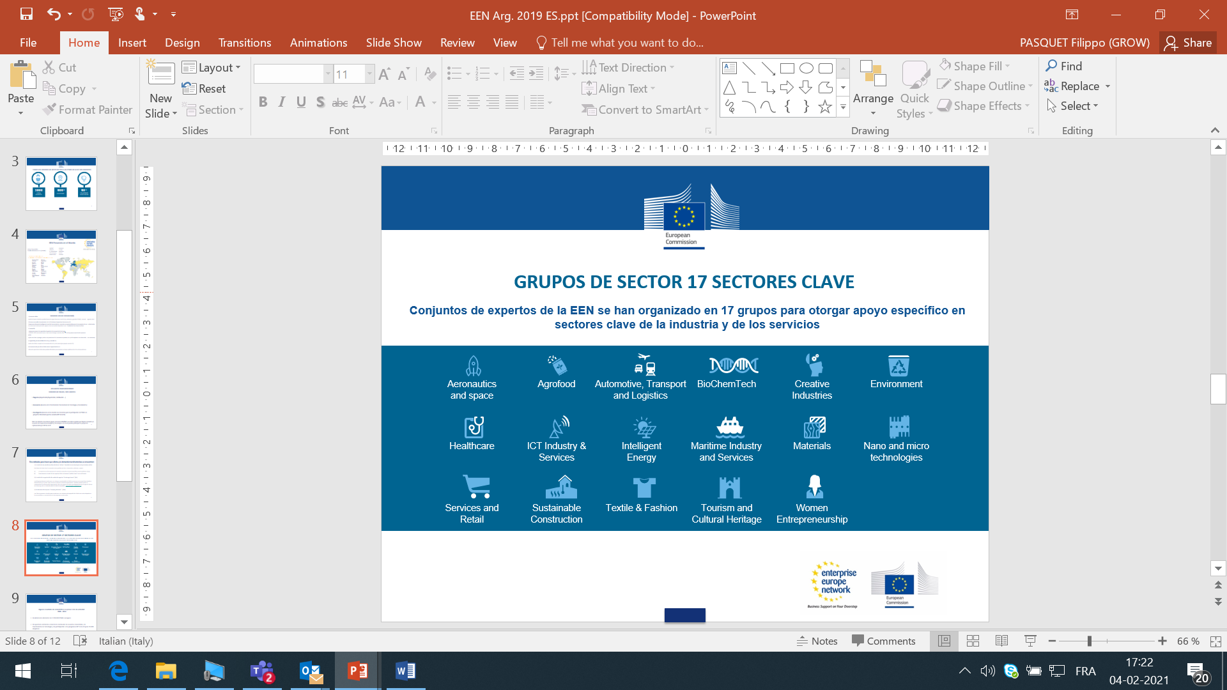
EEN Sector Groups covering 17 key sectors
Sector Groups are made up of EEN experts with a given sector specialisation or interest that have organised themselves in 17 Groups to provide tailored support to SMEs operating in key sectors of the Industry and Services

Slide 14
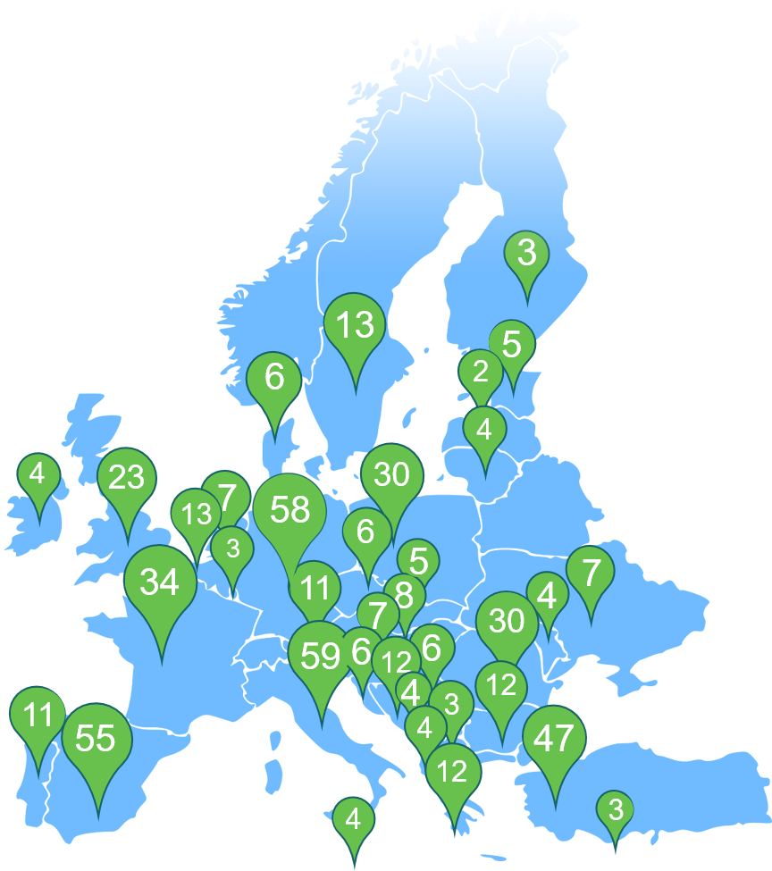

The upgraded EEN 14
SME STRATEGY – UPGRADED ENTERPRISE EUROPE NETWORK
Cooperation and synergies with EDIH and ECCP on digital
Sustainability Advisors
and other sustainability services*
Upgrade to existing Network: ”EEN Vision”
NEW!
Cooperation with ECCP to address SME resilience
Helping SMEs get benefits of Free Trade Agreements
*Figures show number of EEN members in country rather than number of dedicated Sustainability Advisors, which in many cases will be more.

